Slide 1
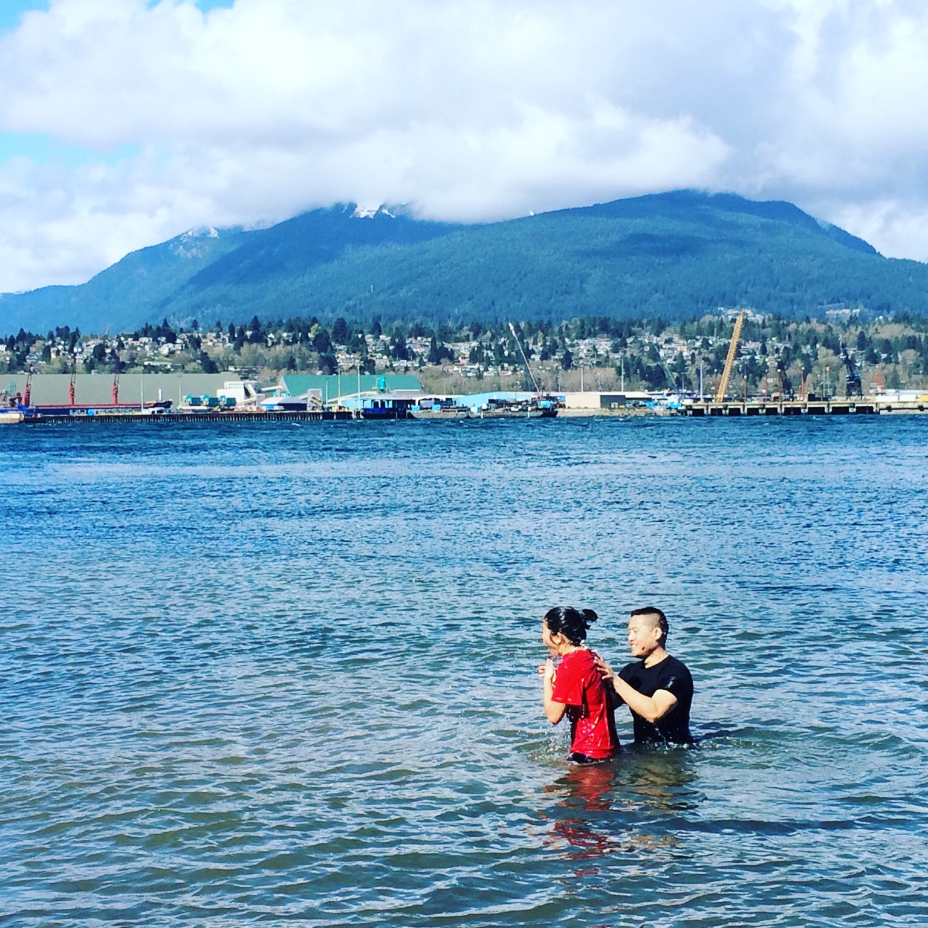
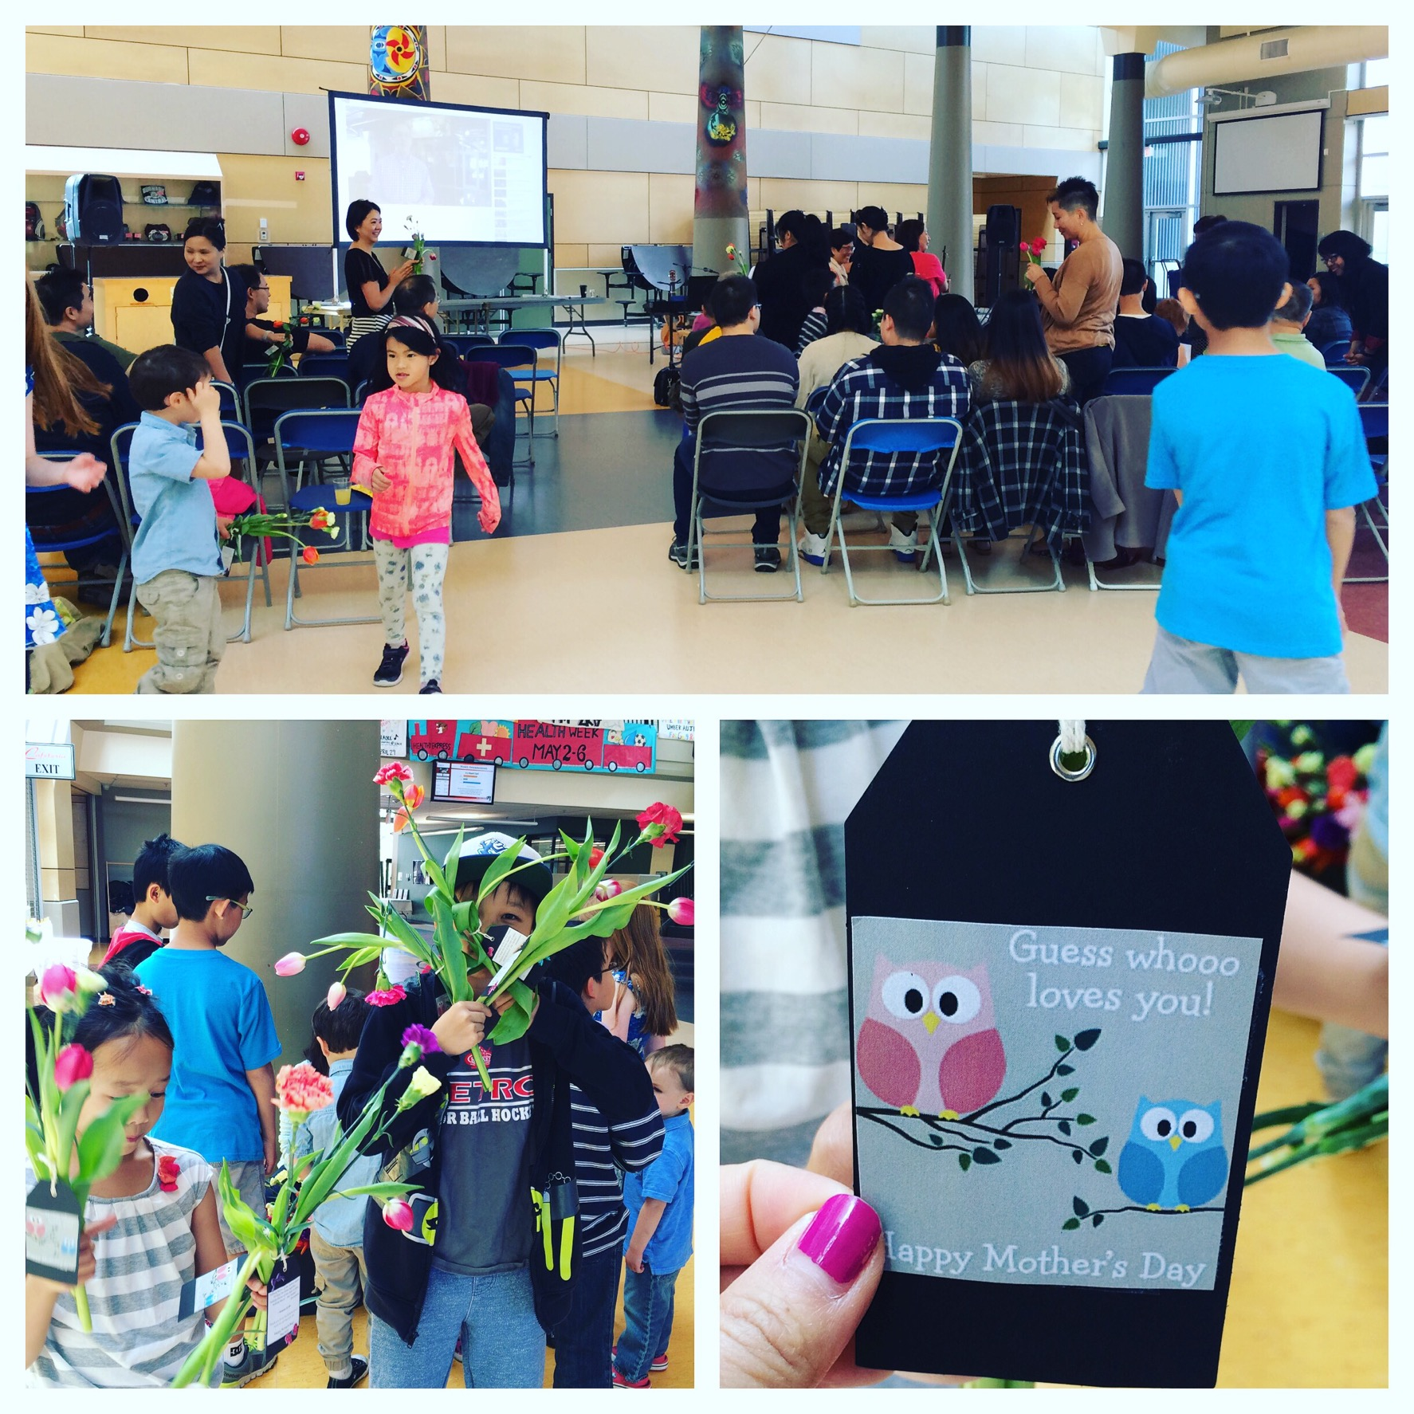
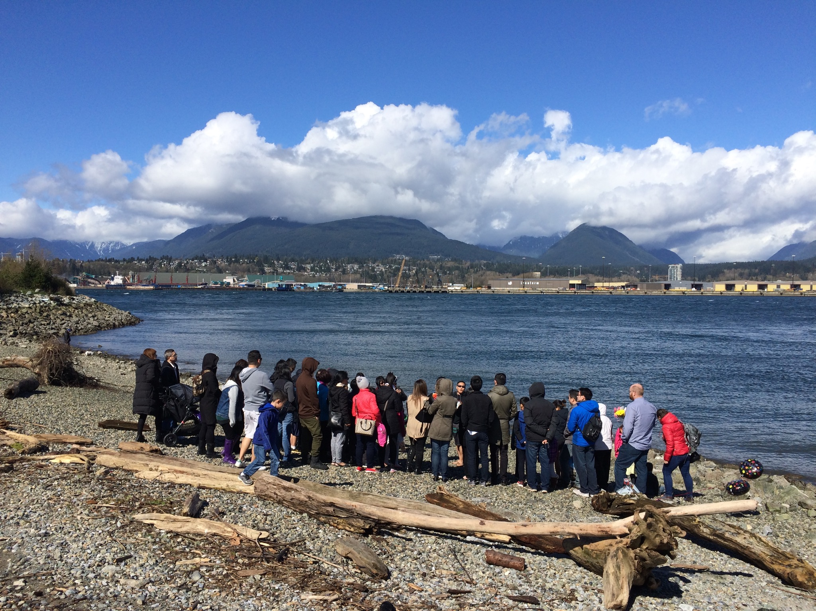
Hope City Church
LPD Church of the Week
This Easter our congregation held a special outdoor service as two of our young people made a public confession of faith through baptism.
Crystel Dumalagan will be joining YWAM’s World Explorer Discipleship Training School in Newcastle, Australia starting and then continuing with Hope for the Nations in the Philippines. Please join us as we pray for Crystal and those she will minister to.
A new elders team has been formed to guide our plant into becoming church affiliated with the LPD & EFCC. Please pray that our team would have wisdom and discernment as we continue to bring the hope of Jesus to Greater Vancouver and beyond.

