Slide 1
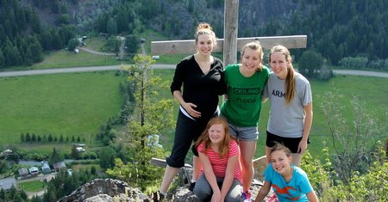
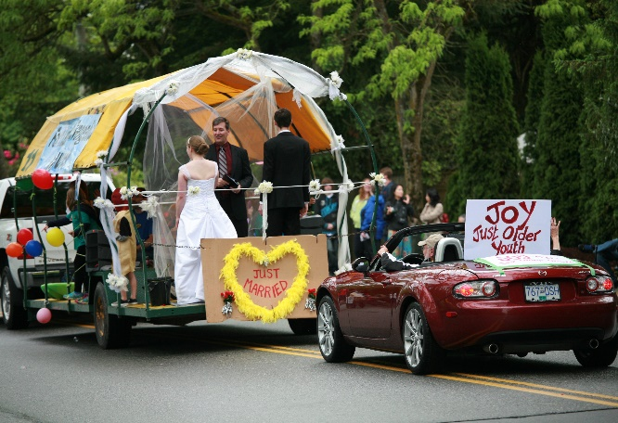
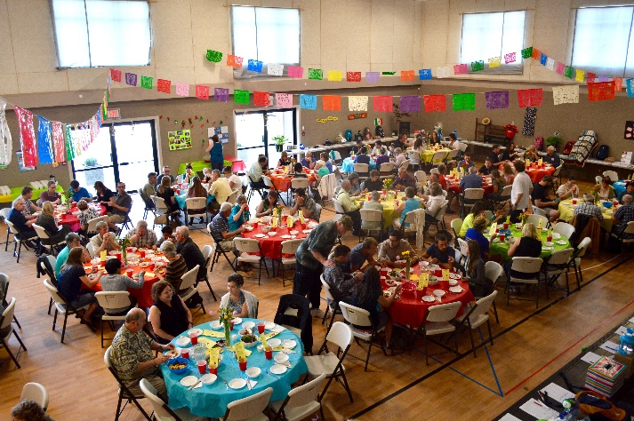
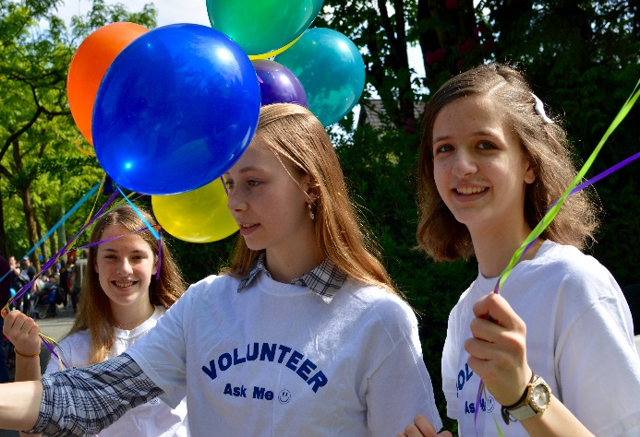
Fort Langley Evangelical Free Church
LPD’s Church of the Week
Please pray for upcoming events:
June 5 – Family Camp @ Camp Tulahead
June 27 – Mexico Missions Trip
July 6-10 – Kids Camp “Everest”
FLEFC loves community involvement!
We just celebrated May Day with Fort Langley ….served over 1,000 hotdogs, passed out balloons and info on FLEFC
and entered a float in the parade.

