Slide 1
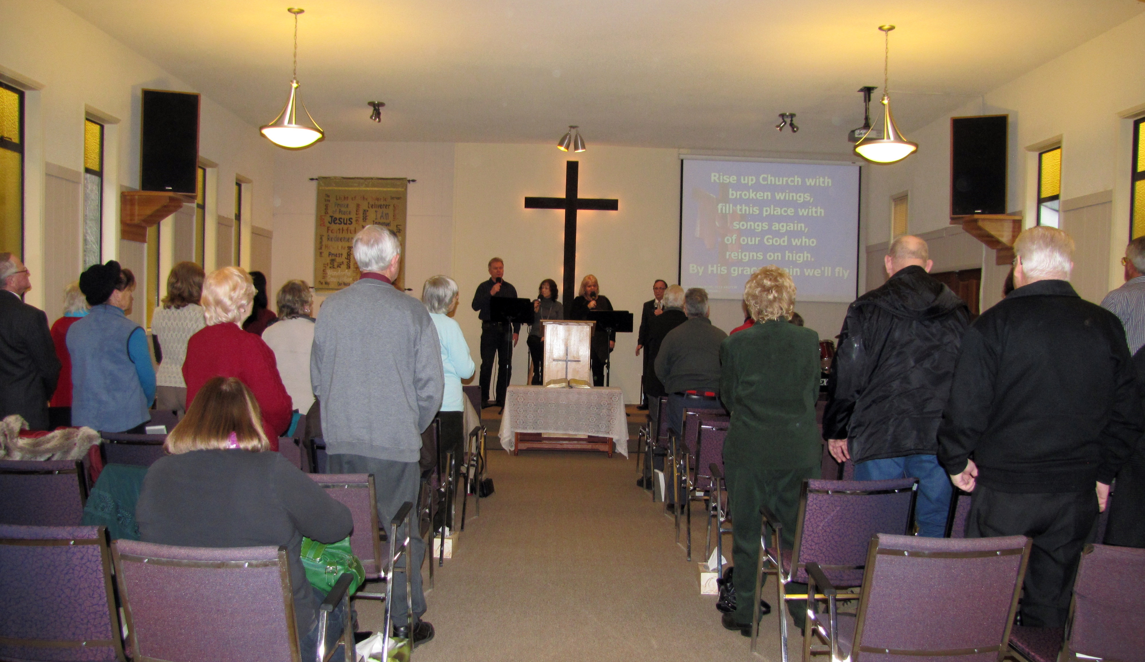
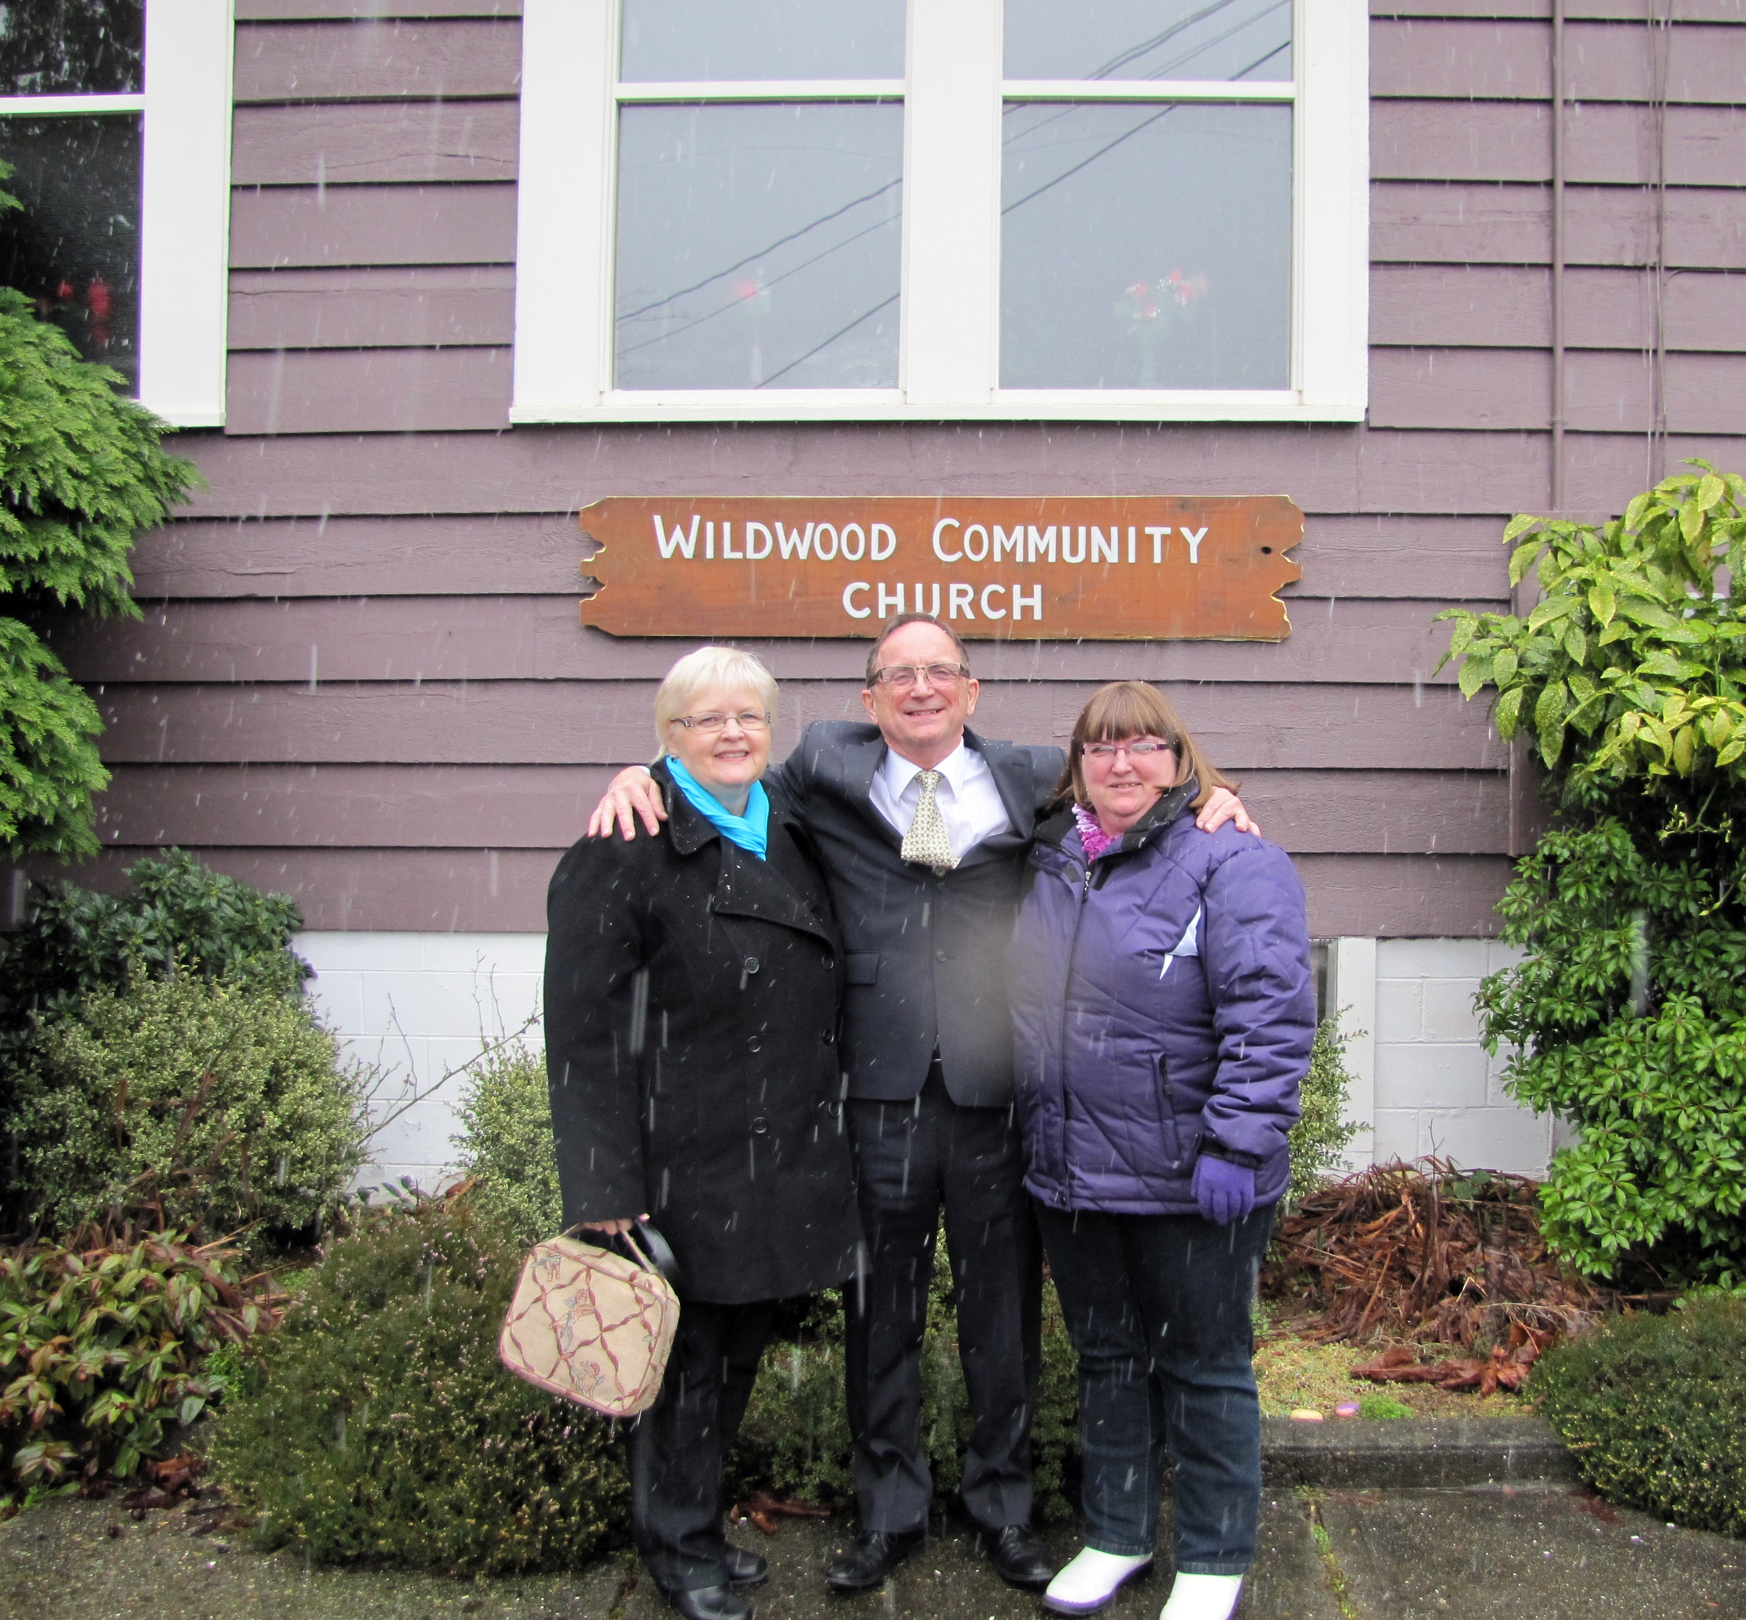
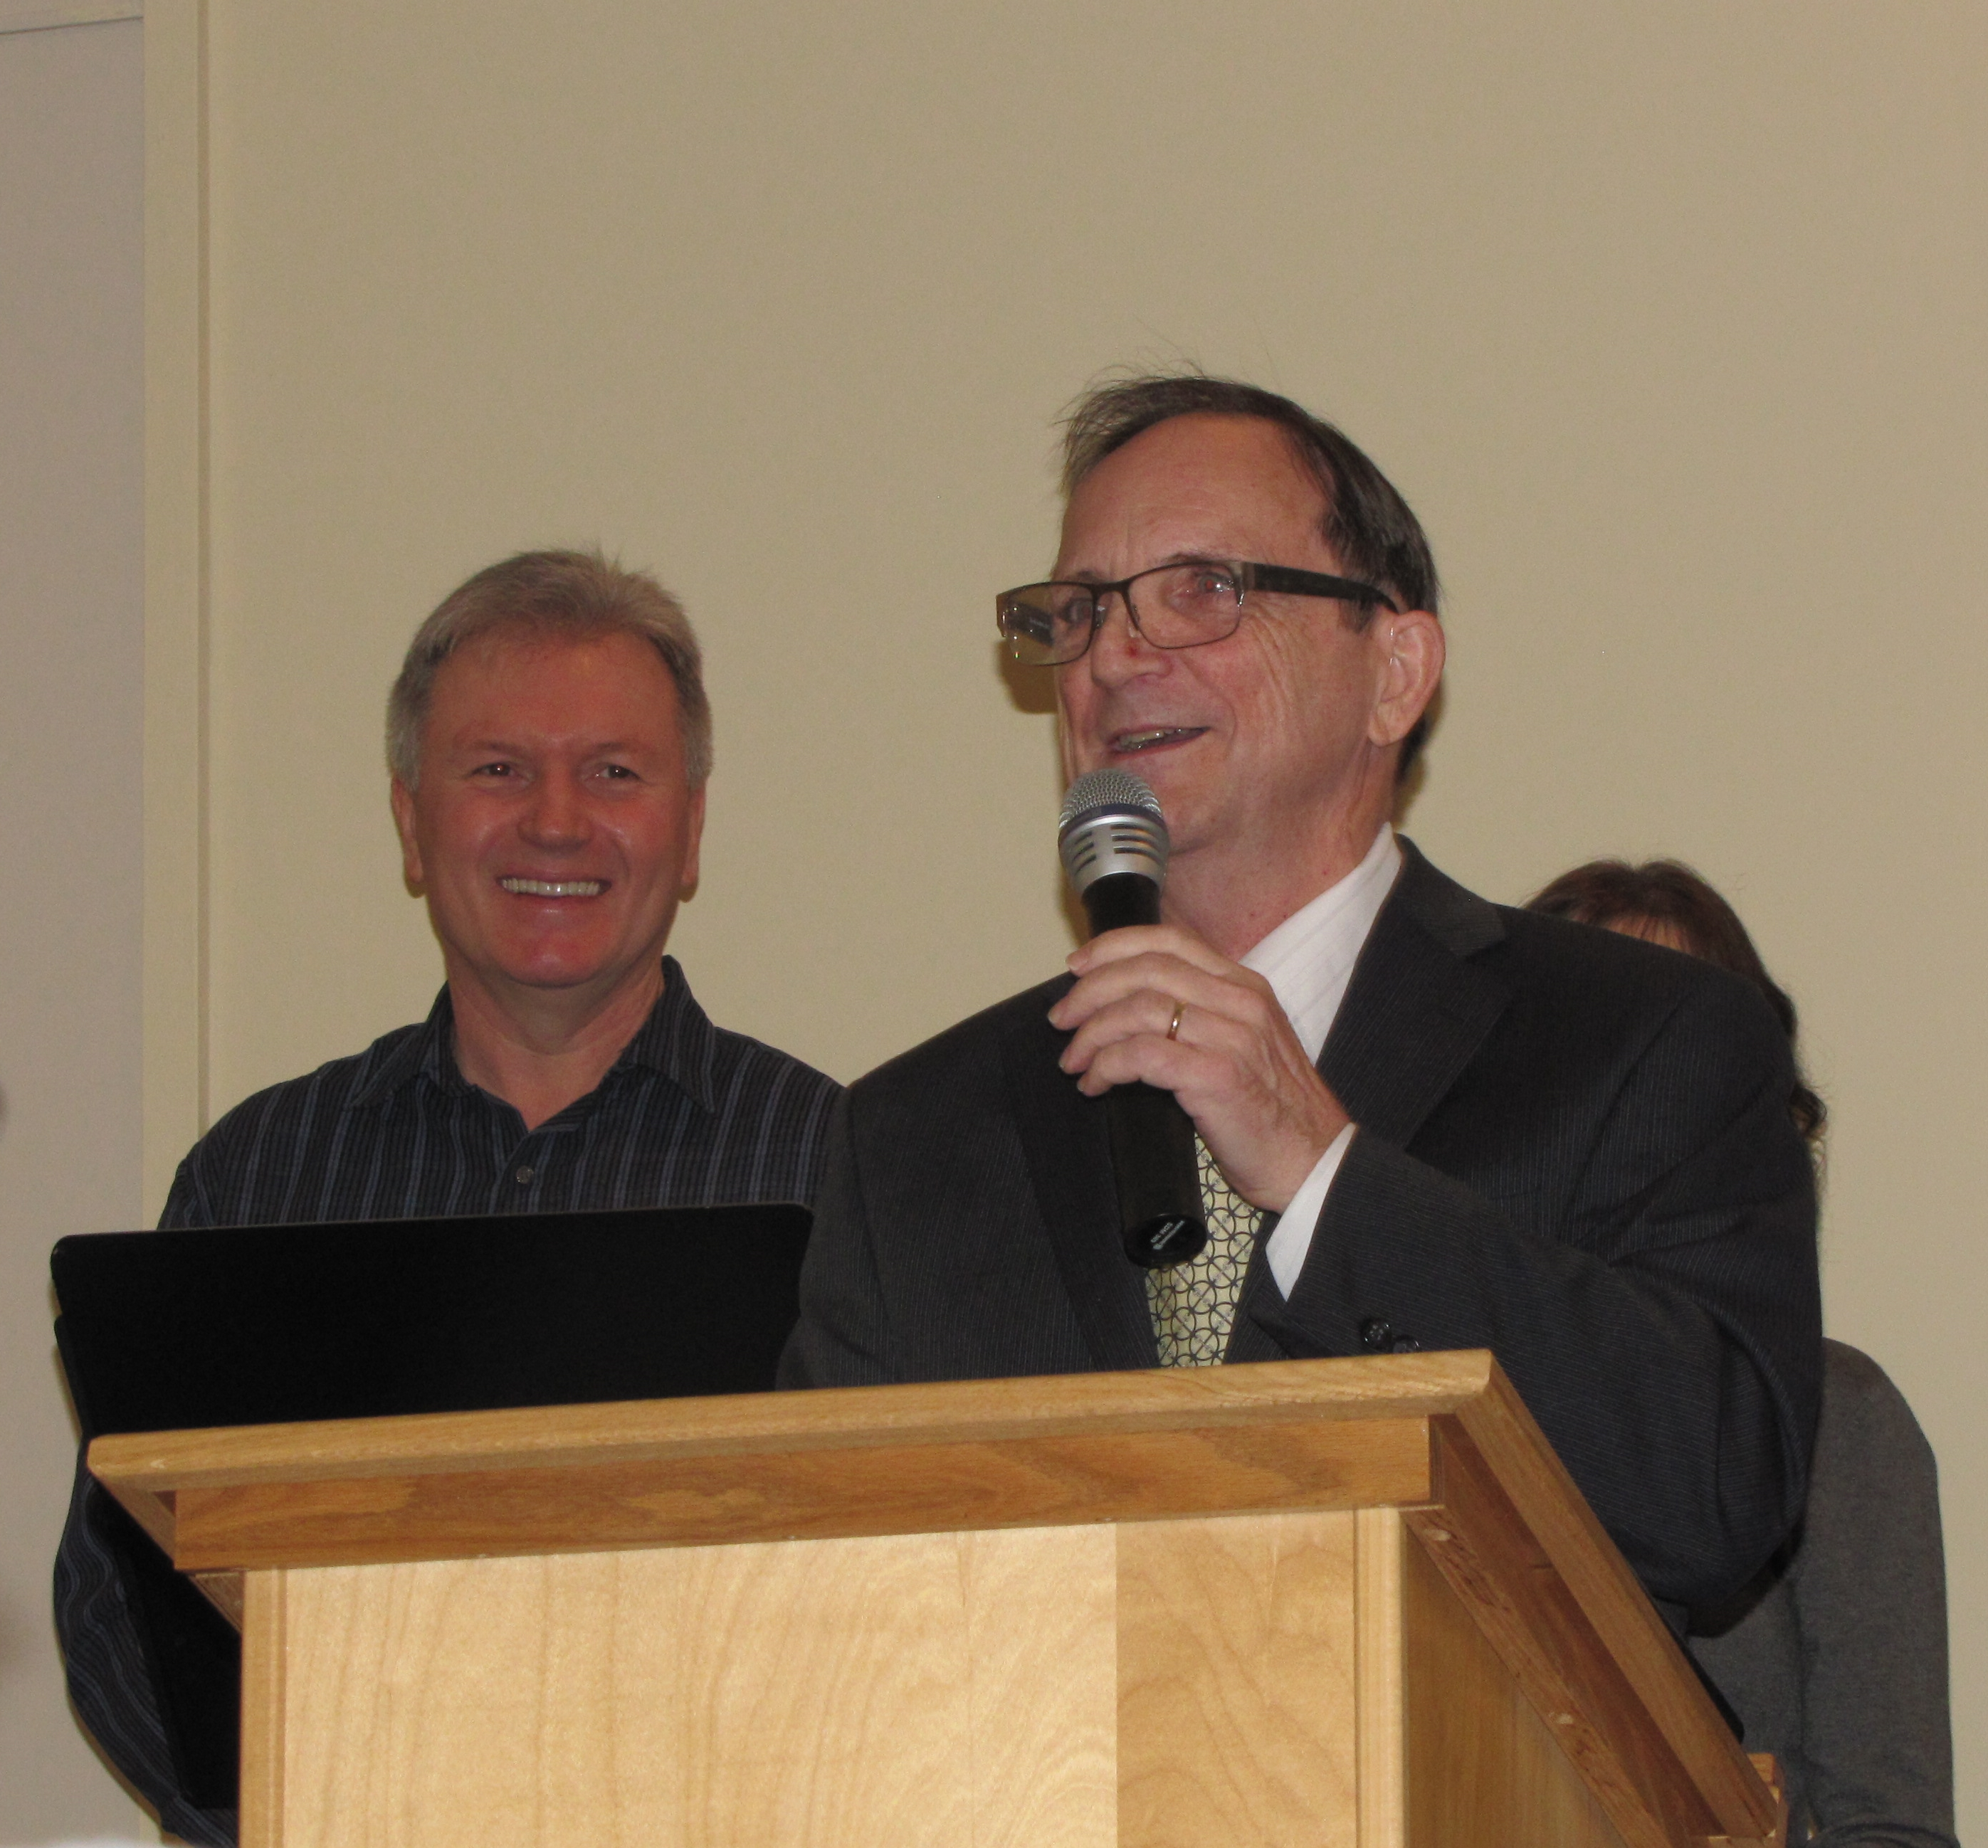
Wildwood Community Church
LPD Church of the Week
I N F O R M A T I O N A N D N E W S
As a more senior congregation particularly, we are thankful for all prayers for health and strength
We are also planning Lord willing a Baptismal service. PTL! We are also celebrating a new 'babe in Christ" as of a couple of weeks ago. God is Good.
Our ladies have just celebrated their annual 'Strawberry tea" which was very well attended and a number of non church ladies came under the Gospel.

