Slide 1
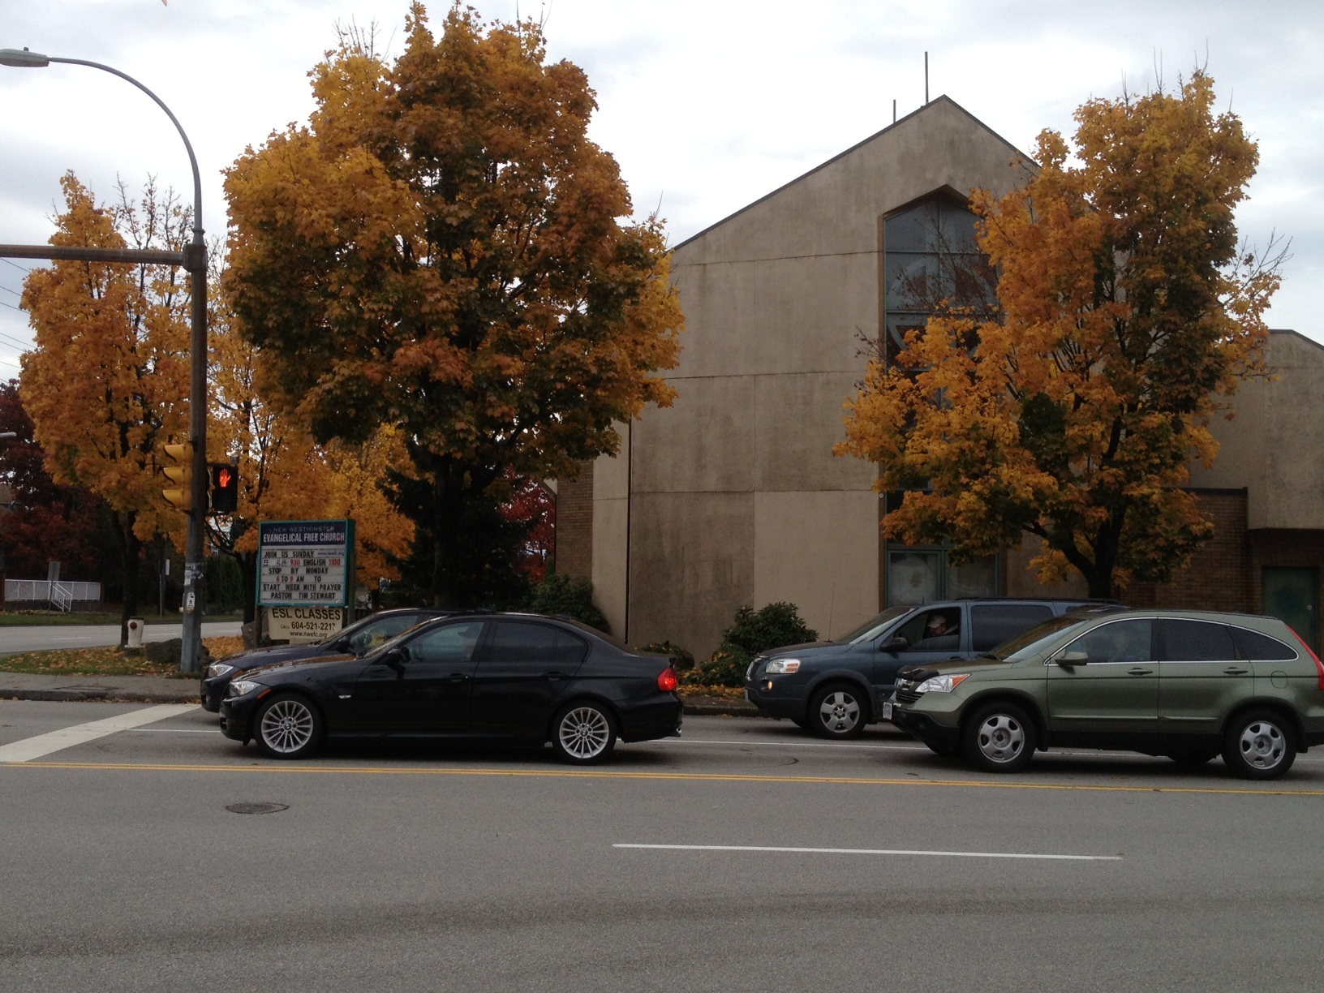
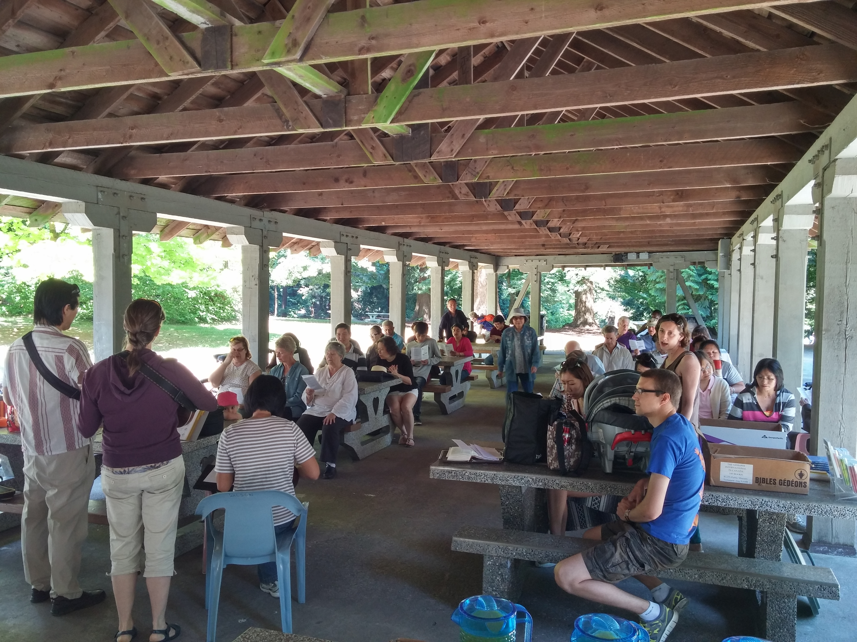
New Westminster EFC - LPD’s Church of the Week
Worship Service Queens Park
“Pray for the peace of your city” (Jeremiah 29:7)
Praise God for the many people who joined us for the event
Please pray for:
God to provide and lead us to the right person to serve as pastoral intern, ideally for the areas of children's, outreach, or worship.
Inward & outward growth in our life group ministries.
New young families, both to serve alongside Tim & Emily, as well as those who are spiritually seeking

