Slide 1
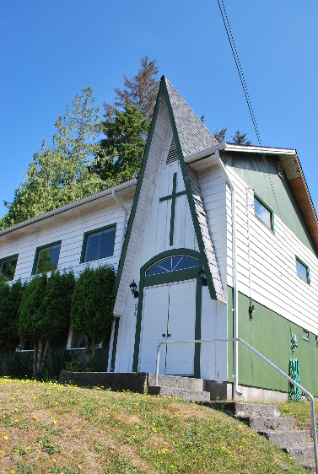
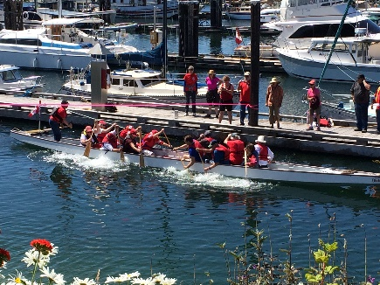
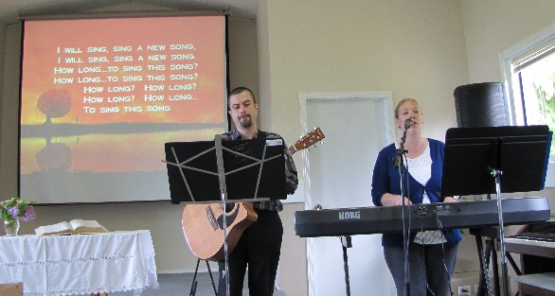
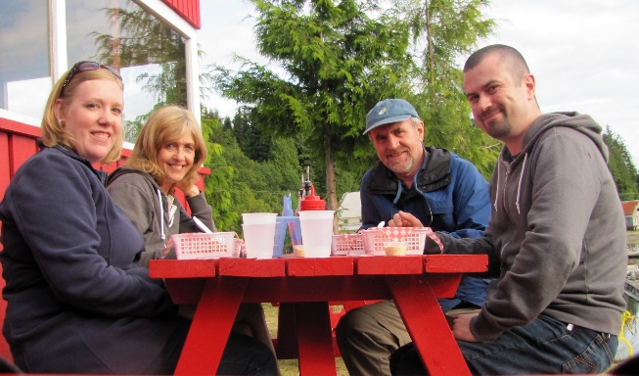
Sointula Community Church
LPD’s Church of the Week
Please pray for Pastor Ben and Anna Crumback as they with the church reach out to their community. Here are some updates:
We are praising the Lord for a great turnout at our annual pancake breakfast which was held on Canada Day!
During the festivities we were challenged to a "dragon boat tug of war" by our local Post Office. It was a lot of fun, and we even managed to win!
We are looking forward to having Rob & Karen Stewart and Ron & Christine Unruh join us for our upcoming church picnic at the end of the month!
Notes:
Faded picture background with full-color overlay
(Intermediate)
Tip: For best results with the picture overlay on this slide, use a picture that is the same dimensions as the slide: 7.5” high and 10” wide. If the picture is not the same height and width, resize or crop to those dimensions before following the instructions below.
To reproduce the background effects on this slide, do the following:
On the Home tab, in the Slides group, click Layout, and then click Blank.
Right-click the slide and then click Format Background.
In the Format Background dialog box, click Fill in the left pane. In the Fill pane, select Picture or texture fill, and then under Insert from, click File.
In the Insert Picture dialog box, select a picture, and then click Insert.
Also in the Format Background dialog box, in the Fill pane, in the Transparency box, enter 50%.
Also in the Format Background dialog box, click Picture Color in the left pane. In the Picture Color pane, under Recolor, click the button next to Presets, and then click Tan, Background color 2 Light (third row, first option from the left).
On the Insert tab, in the Images group, click Picture.
In the Insert Picture dialog box, select the same picture chosen for the background, and then click Insert.
Select the picture. Under Picture Tools, on the Format tab, in the bottom right corner of the Size group, click the Size and Position dialog box launcher. In the Format Picture dialog box, resize or crop the image so that the height is set to 7.5” and the width is set to 2.25”.
To crop the picture, click Crop in the left pane, and in the Crop pane, under Crop position, enter values into the Height, Width, Left, and Top boxes.
To resize the picture, click Size in the left pane, and in the Size pane, under Size and rotate, enter values into the Height and Width boxes.
Also in the Format Picture dialog box, click Glow and Soft Edges in the left pane, and then in the Glow and Soft Edges pane, under Soft Edges, in the Size box enter 10 point.

