Slide 1
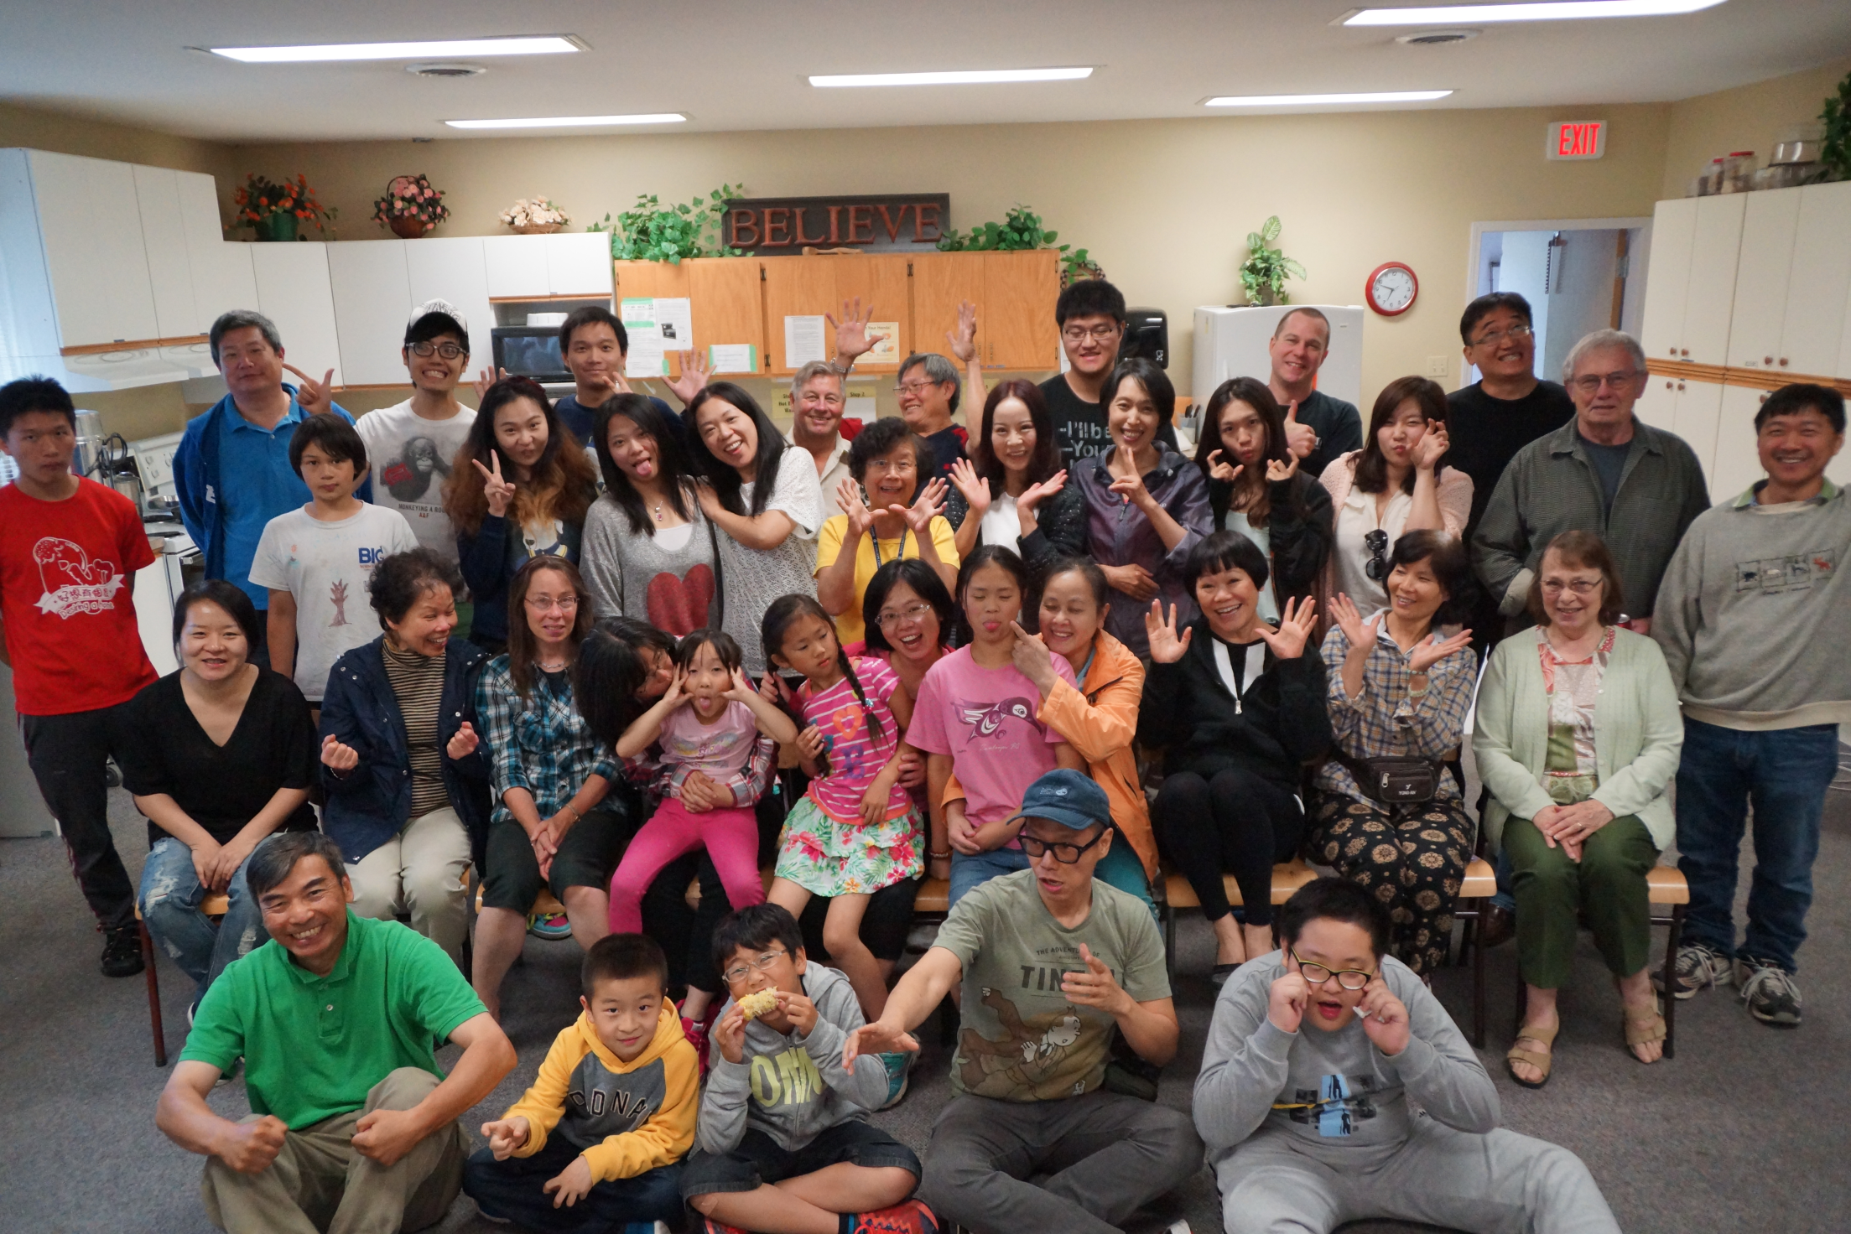
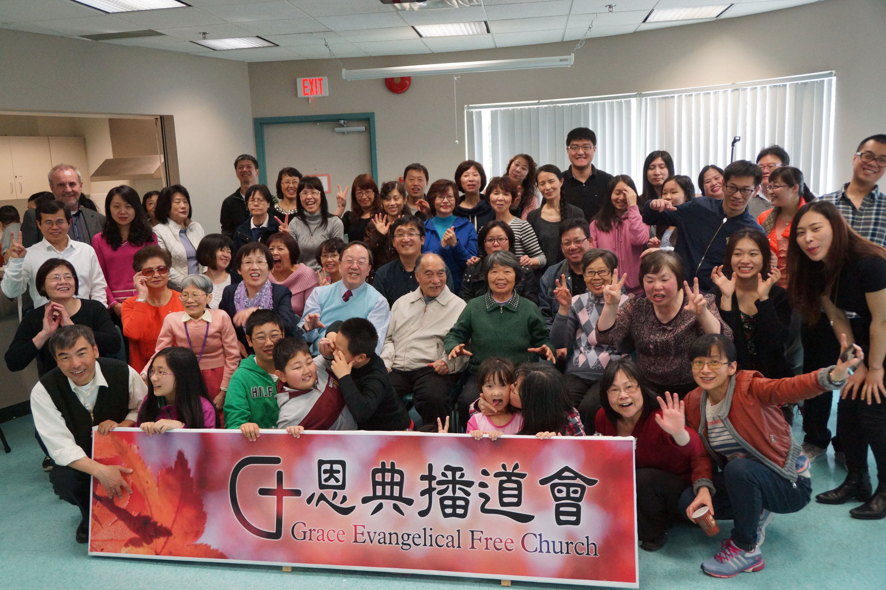
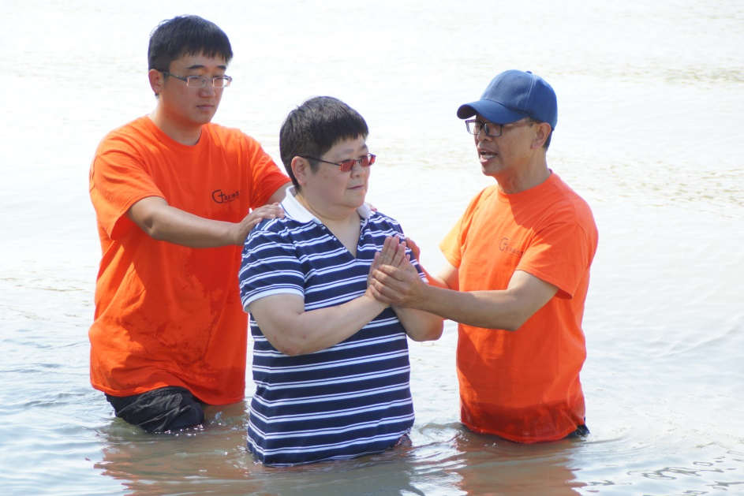
Grace EFC
LPD church of the week
Pray for spiritual growth and maturity of Richmond and Fort Langley Campuses
Pray that God sends us more humble, gifted and united coworkers
Pray for wisdom inn planning for the small groups, Sunday School and further development of campuses
Pray for the upcoming planning, strategy and ministry in TWU and Kamloops
Praise God that after 2 years of waiting, we finally received our CRA Society status
Visiting Kamloops CEFC
3rd Anniversary
5 Baptized July 5
Worship with TWU students

