Slide 1
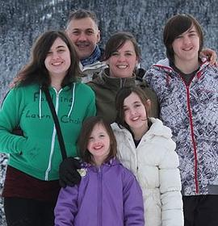
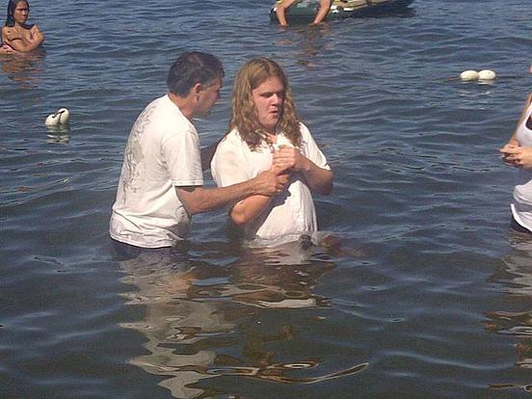
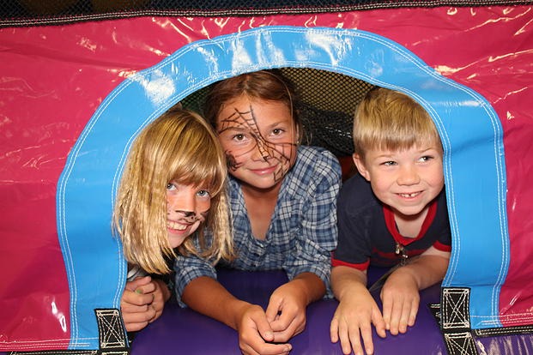
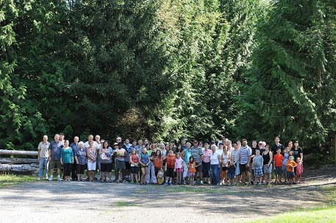
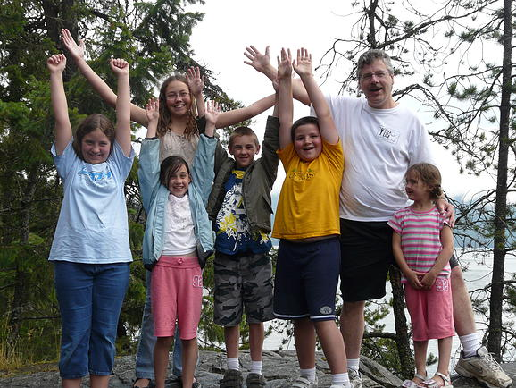
Mountain View EFC
Please pray for Pastor Evans and Donnae Hundermark while away on sabbatical until September 1st
We are grateful for Heath Meikle, a former missionary with CTEN, who has been our relief speaker in Pastor Evans’ absence
Please pray for our testimony Sunday outdoor service on September 9th
Please pray for our fall kick-off on September 13th!
LPD’s church of the week

