Slide 1
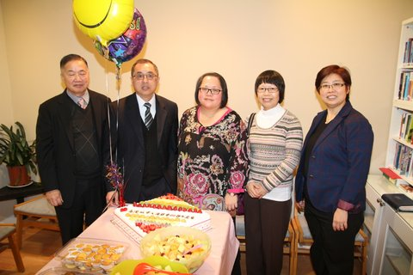
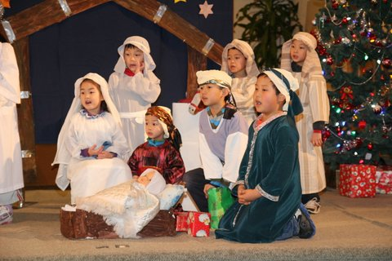
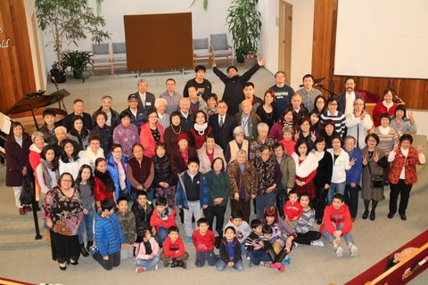
Coquitlam Chinese EFC
LPD Church of the Week
Please pray for Coquitlam Chinese EFC, and for Pastor Ting Pong (Melanie) So:
English Ministry:
Pastor Ranjith Perera & English congregation, for spiritual growth in this ministry
Children’s Ministry:
Worship, Choir
Young Parent Ministry:
Sunday school & that the gospel would reach the community
Church Board:
For God’s guidance to the Pastors & Deacons as they lead the church

