Slide 1
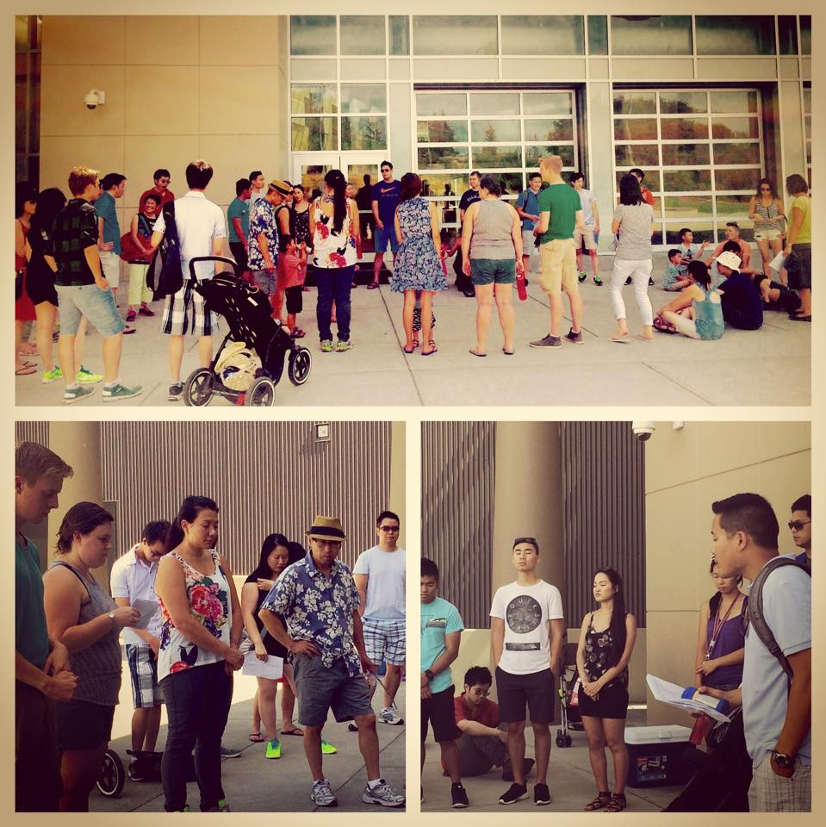
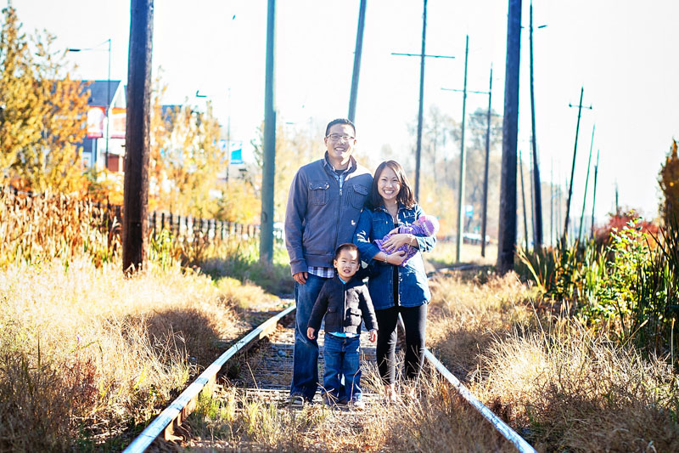
Pastor Philip and Grace Yung
LPD Church of the Week
Please pray for:
Discernment as we search for a pastor of spiritual formation to join our team
Community and mission as we launch of life groups for the new year
Finding opportunities to serve our local neighbourhood
We are two weeks into a teaching/life group series on the missional church. We are praying God would continue to shape us as disciple-makers in Greater Vancouver.

