Slide 1
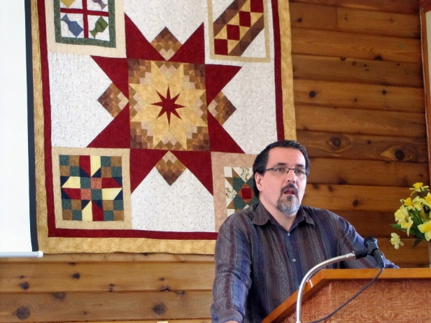
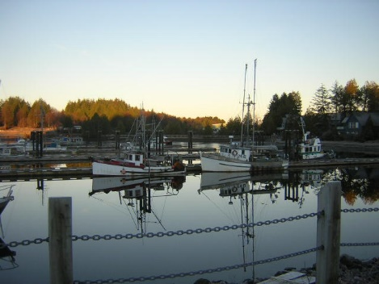
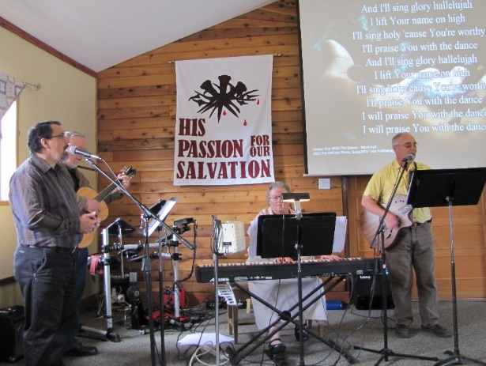
Christ Community Church
LPD Church of the Week
Founded during WWII, Christ Community Church welcomes everyone in the name of Christ and seeks to be a community of followers of Jesus Christ, committed to live by faith, to be known by love, and to be a voice of hope.
Please pray for Christ Community Church, our church in Ucluelet, on the west coast of Vancouver Island. Pray for Pastor Miles and Lorie White, and for the ministry and witness of the church in the community.

