Slide 1
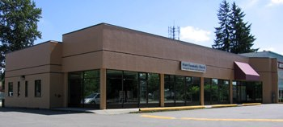
Grace Community Church
LPD Church of the Week
Please join in a prayer of thankfulness for Grace Community Church in Pitt Meadows, and Pastor Colin and Beth Peters, and in particular for:
The continued work of God in His people’s hearts
The spiritual growth of young couples
The spiritually active and Godly older people
The 50 kids who attend Sunday School
The diversity of the church in age/country of origin
Fellowship lunch held twice a month
Church camp and the 6 who were baptised
Upcoming 20 year celebration/thanksgiving dinner in November
Discernment as they face the issue of space
The welcoming and active church family who share in church ministry

