Slide 1
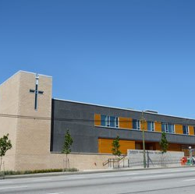
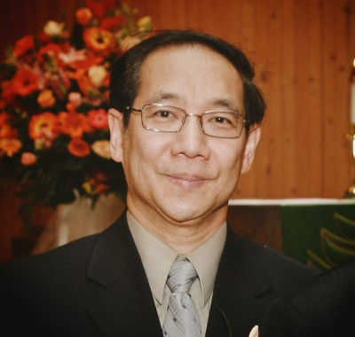
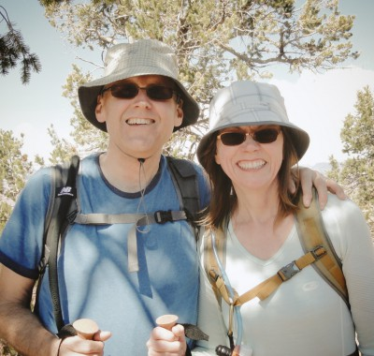
Vancouver Chinese EFC
LPD Church of the Week
Please pray for Vancouver Chinese EFC, our LPD Church of the Week. Praise God for His work as the church celebrated its 40th anniversary this month with a dinner for approximately 600 people. Please pray for Pastor Edward (Ruby), Pastor Dan (Sharon), Pastor Wai-Mui (Rick), Pastor Job (Cindy), Interns Chris (Sabrina) and Danny (Erico), and the leadership team as they minister each week in Cantonese, Mandarin and English, in reaching out to the people of Vancouver. Please also pray for a strengthening in the youth turnout.
Ed Lee
Dan Williams

