Slide 1
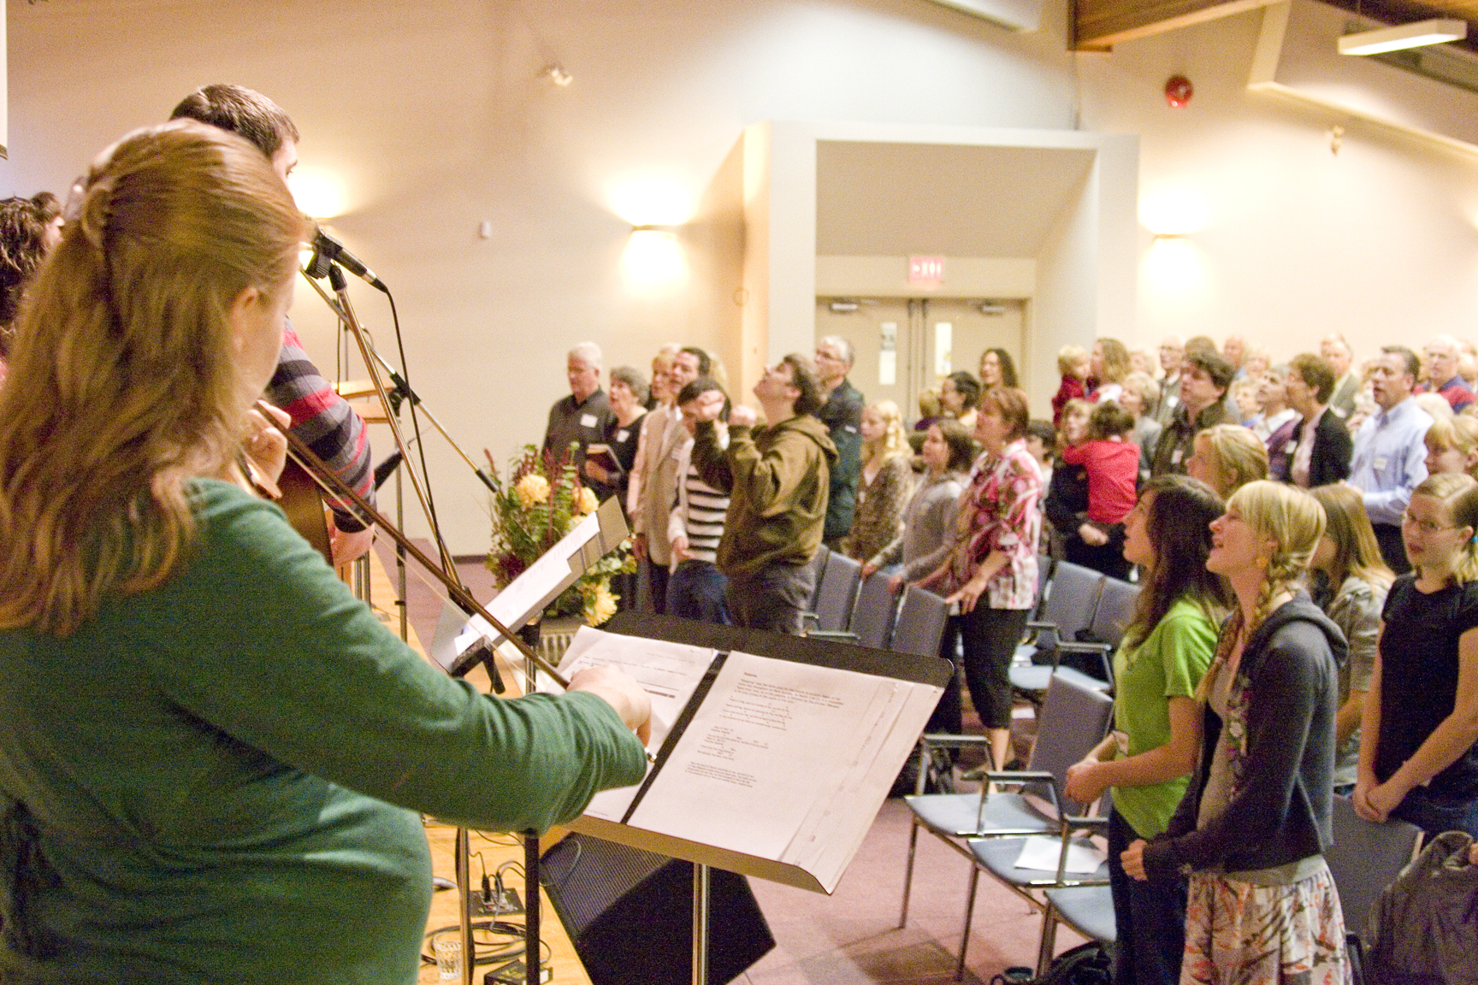
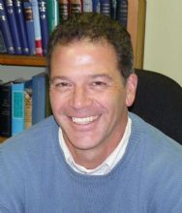
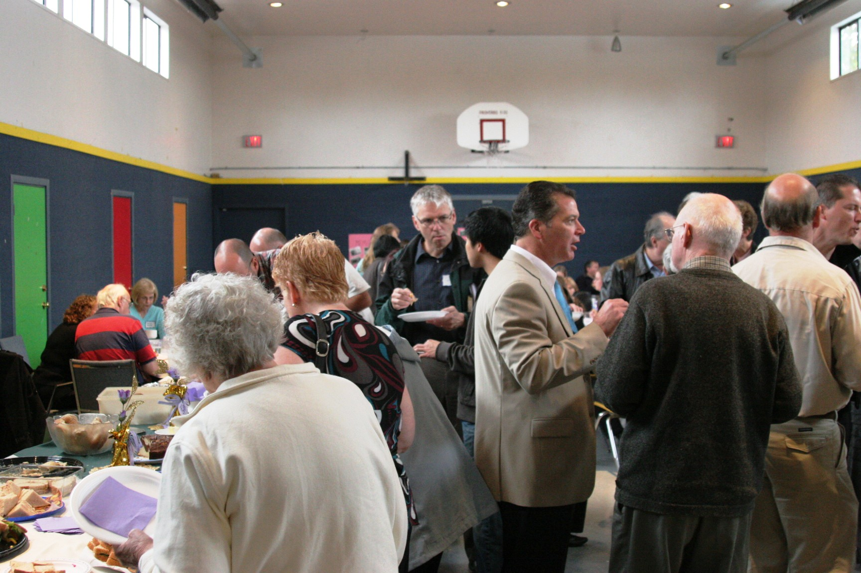
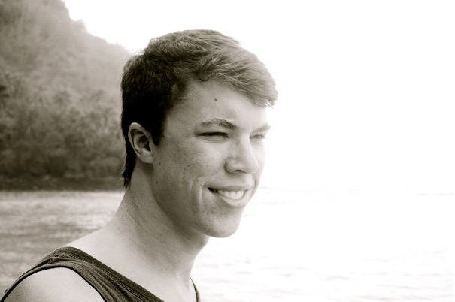
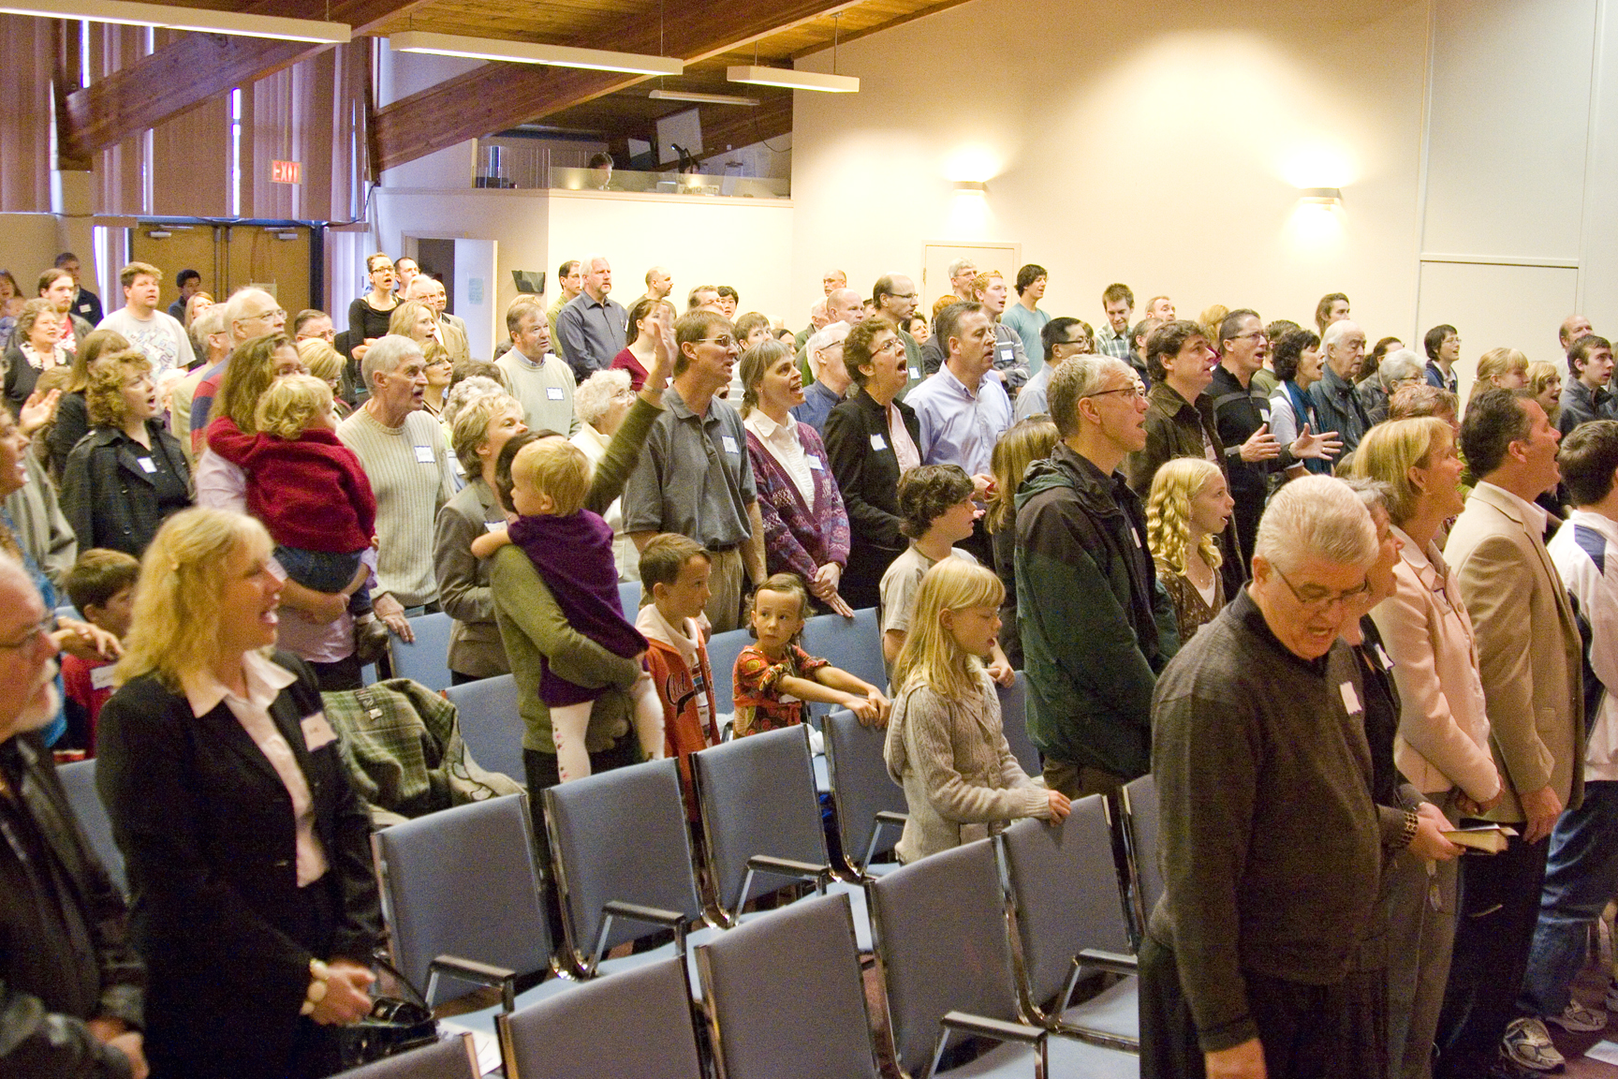
NORTH Delta efc
Lpd cHURCH of the week
Praise points:
We are thankful for the new people that God continues to bring to our church
A number of people have asked for baptism and membership
Prayer requests:
For wisdom as we discern our response to the refugee crisis
For the coming Advent season when a number of outreach events will be happening including ladies teas, church and youth banquets, and Christmas Eve services
Upcoming events:
Besides the outreach events we have challenged our church to be inviting people to join us for the Advent season beginning Nov 29 and a special Advent sermon series
Lead Pastor
Mark (Tami) Johnson
Youth Pastor
Stewart Warnock

