Slide 1
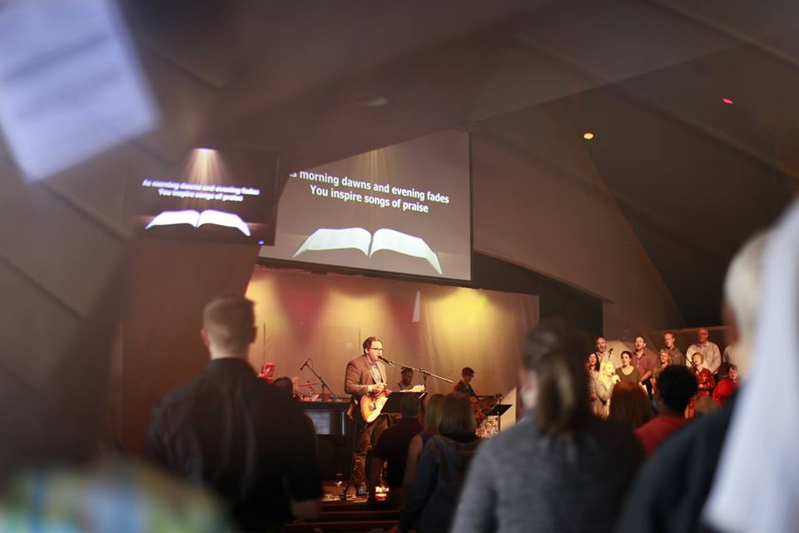
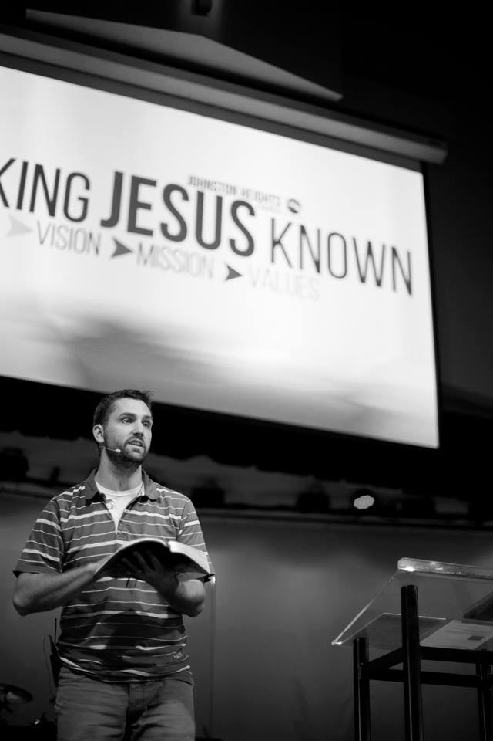
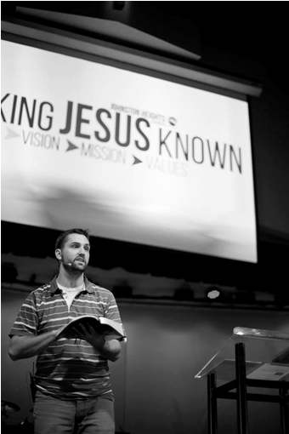
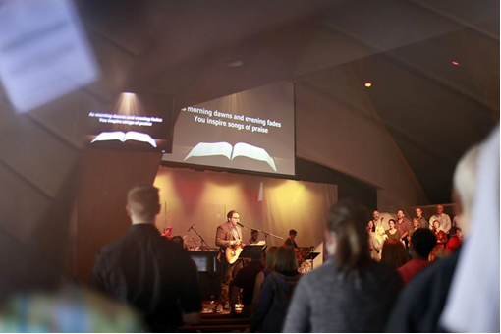
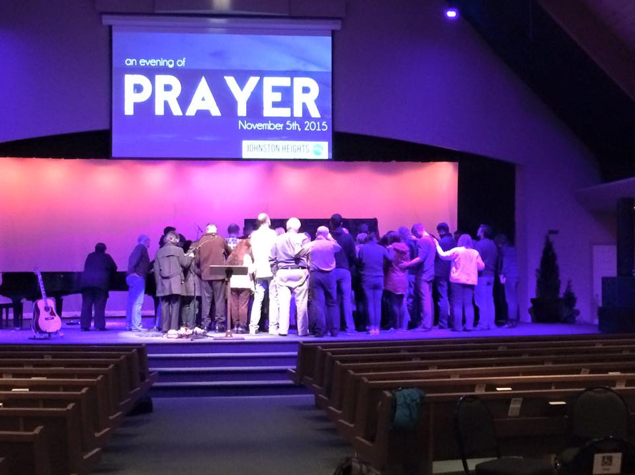

Johnston Heights EFC
LPD Church of the Week
This will be the 26th year of the Christmas Production [it runs from Dec 2-6]. "Kringle's" is a story of forgiveness and reconciliation perfect for the most wonderful time of the year!
-May the Lord continue to bless us as we seek to effectively make Jesus known in every community where God places us!
-We continue to strive to be a house of prayer

