Slide 1
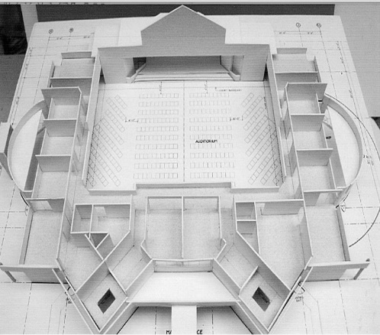
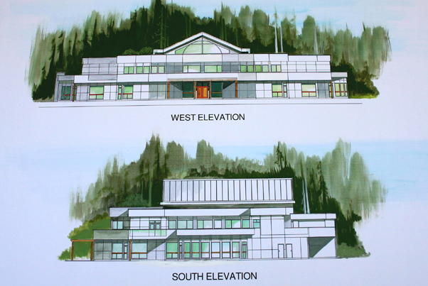
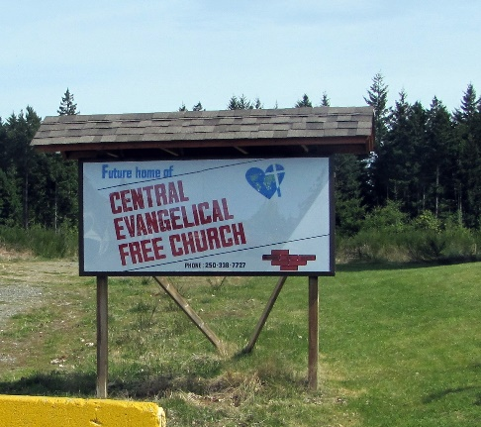
Central EFC
LPD Church of the Week
Please pray for:
Wisdom in decision making at congregational meeting Nov 9 regarding the new church building
Jeremy, Lauren and Lexi Boehm as they go through the adoption process. Pray that baby Nikolai, will officially be theirs and come home soon.

