Slide 1
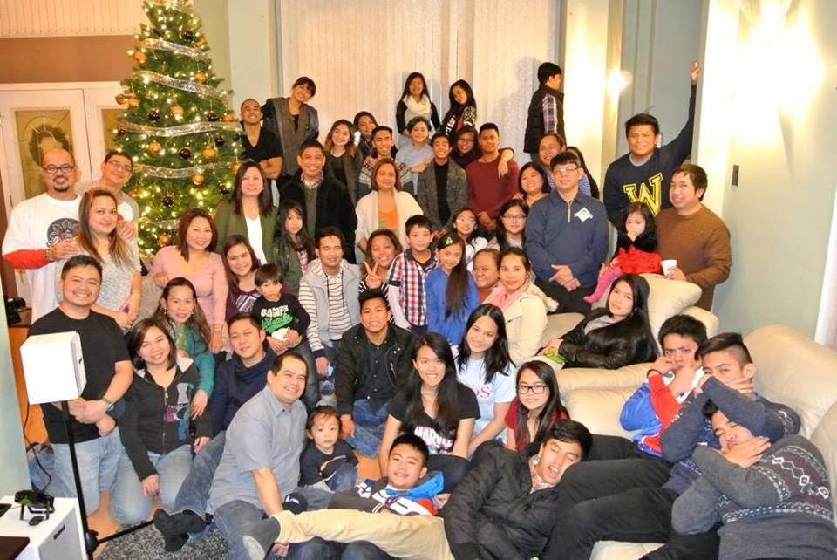
Jesus Is Our Salvation
Praise God for:
Our 6th year anniversary celebrated
Nov 29, 2015
The unity of the church in spite of the absence of a full time ministry worker
His continuous strength and wisdom given to leadership
Please pray for upcoming events:
December 19 pre-Christmas celebration
Training in cultural connection
Subtitle
LPD Church of the Week

