Slide 1
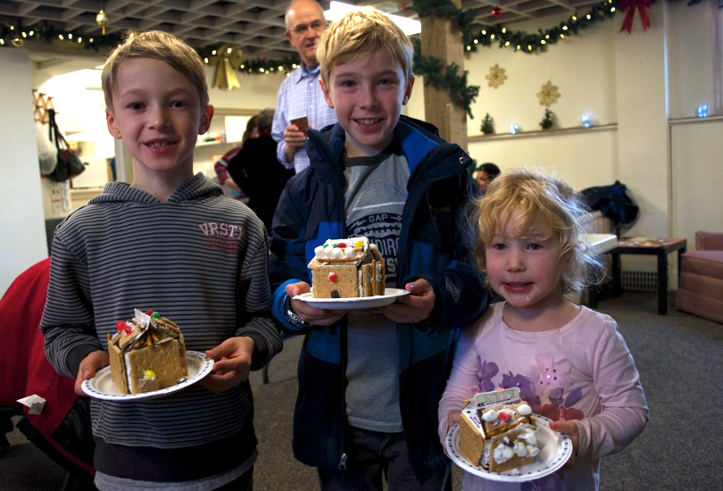
Lpd cHURCH of the week
Lead Pastor: Steve Doerksen
Associate Pastor: Ken Strom
Youth Pastor: Orin Saunders
Worship Director: Tennyson Vaughn
Praise points:
Praise God for the opportunity to be a part of the community-wide Christmas on the Peninsula Celebration in White Rock.
55 kids participated in making Gingerbread Houses & a small
group of carollers ministered around town.
We praise God for 2 people getting baptized last month.
Prayer requests and upcoming events
For the Advent season and the outreach events on Christmas Eve
For hearts to be open to the true meaning of Christmas.

