Slide 1
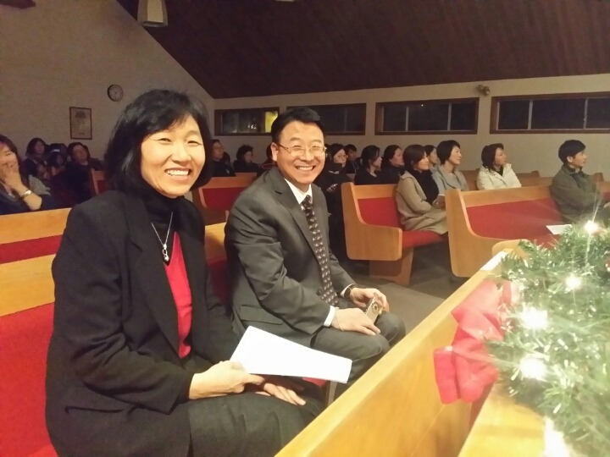
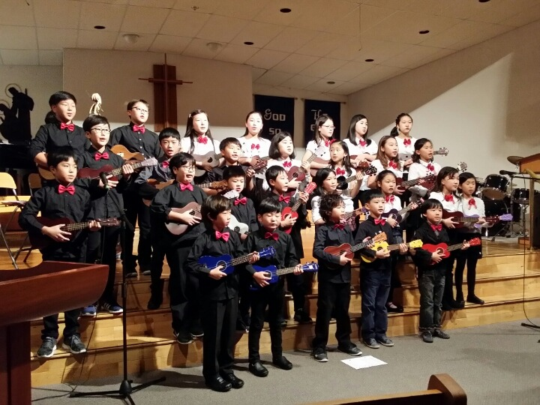
The Church of the
Sent For Life Proclamation
Praise God For:
Baptism Dec 27
Growth in 2015
First Nations mission trip
Prayer Requests:
2016 team election
CRA charity process
Team leaders retreat
LPD Church of the Week

