Slide 1
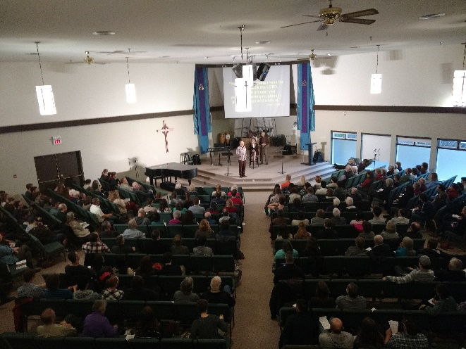
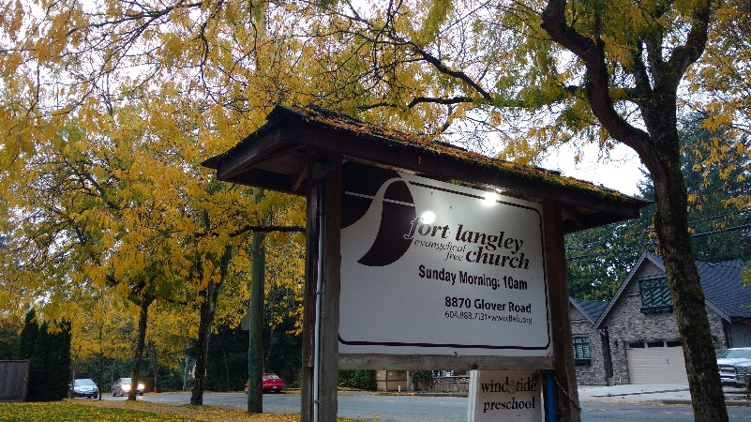
Fort Langley EFC
Praise points:
The Christopher Yuan conference on Holy Sexuality was a success and gave many an opportunity to dialogue on this important issue. Many LPD and EFCC churches were able to participate through live streaming.
The technology for our video streaming in our second venue is working more consistently, relieving much stress!
Prayer requests:
Discernment as we decide as a church how to best respond to the Syrian Refugee crisis.
Provision of individuals with a heart for worship who can get involved with our worship teams.
God’s guidance as we vision together ways to see unbelievers come to faith in Christ.
Upcoming/Recent Past events:
Annual General Meeting in February
Refugee Information Night in January
LPD Church of the Week

