Slide 1
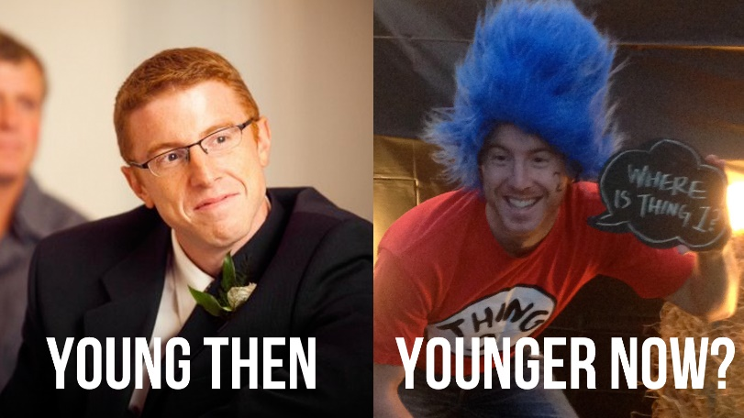
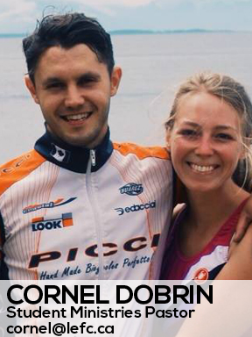
LANGLEY EFC
LPD Church of the Week
January kicked off in with great things at LEFC. We hired a new Student Ministries Director, Cornel Dobrin and celebrated Pastor Darren Young's 10 years of ministry with LEFC! Meanwhile we're one week away from starting Global Outreach month in February where we'll engage the congregation in raising the funds for 2016 to support 11 career missionaries and 3 special projects (Seeds of Hope in Zambia, Hope for Korah in Ethiopia, and EFCCM's ministry in Cuba.) As part of this we trust God that we will be able to send short term teams to all three of these locations this year.
Pastor Darren Young

