Slide 1
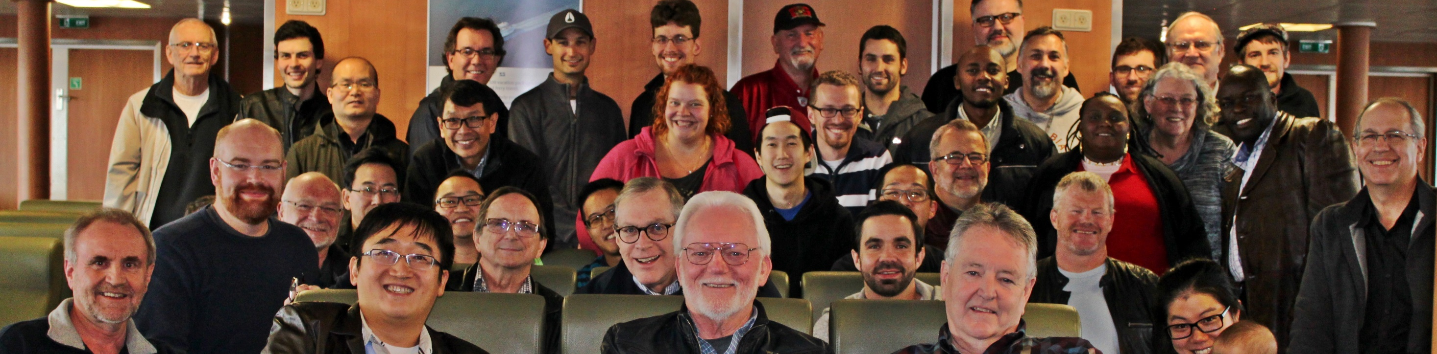
Happy New Year!
God's blessings for a fruitful and joyous 2016
from your LPD Family
“God is faithful, who has called you into fellowship with His Son, Jesus Christ our Lord.” 1 Corinthians 1:9

