Slide 1
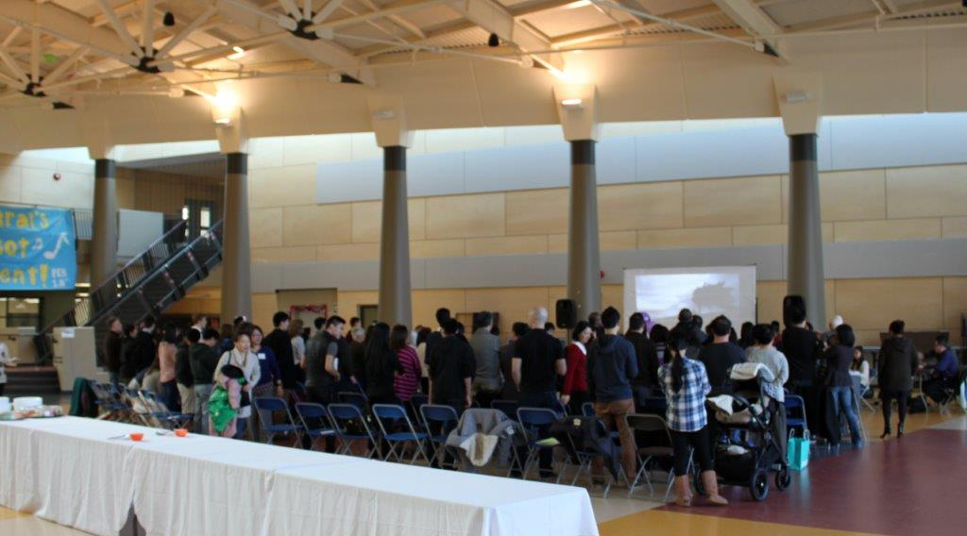
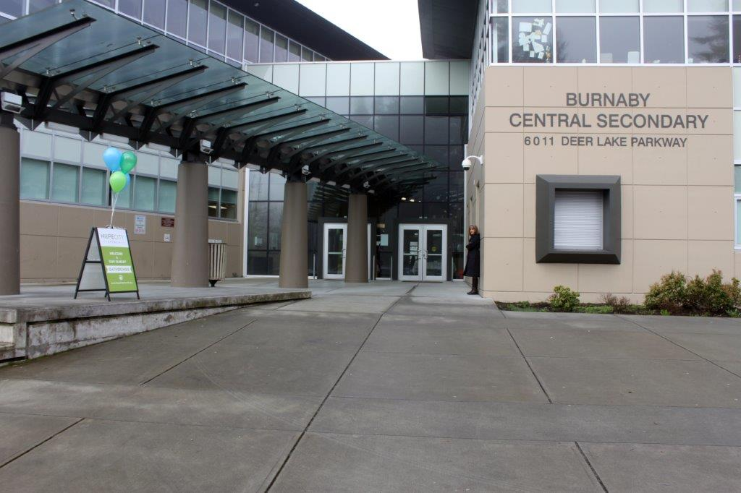
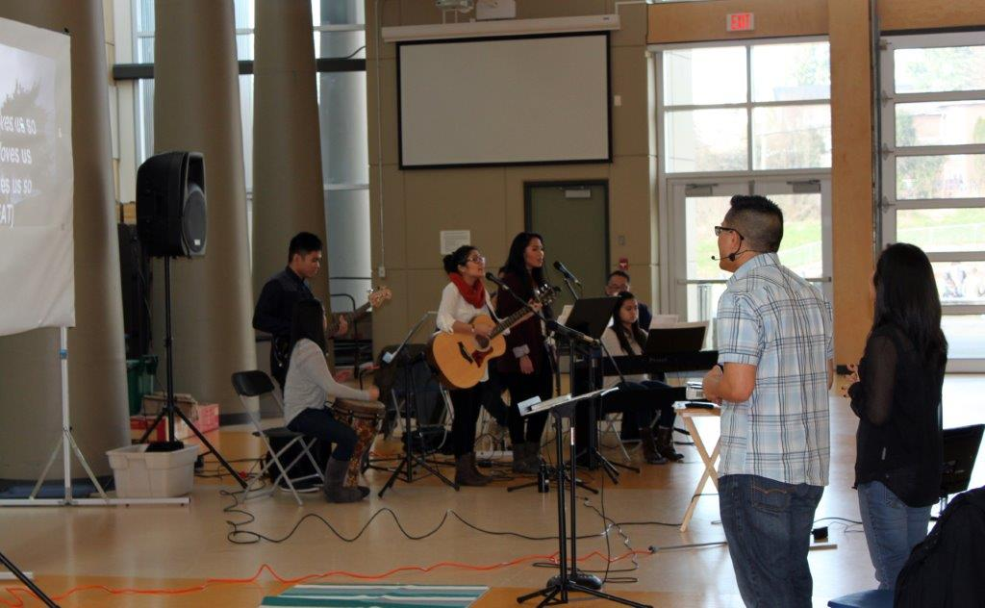
HOPE CITY CHURCH
LPD Church of the Week
Prayer Items
The development of a team of elders for vision, accountability, and administration.
Prayer Items
Baptisms on Easter Sunday!
Celebrating one year anniversary (Feb 13 2015)

