Slide 1
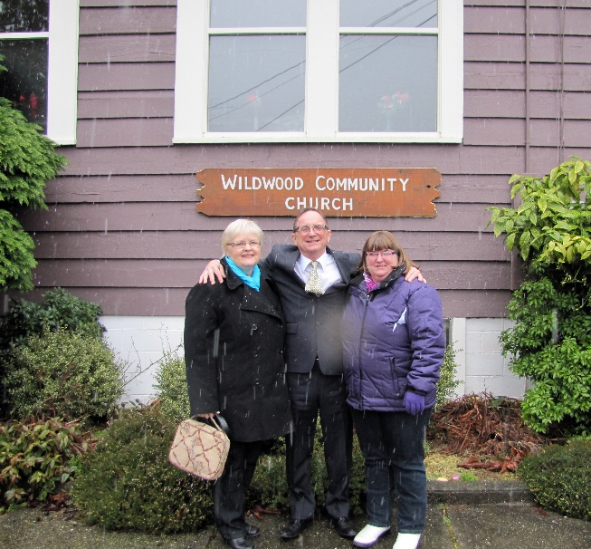
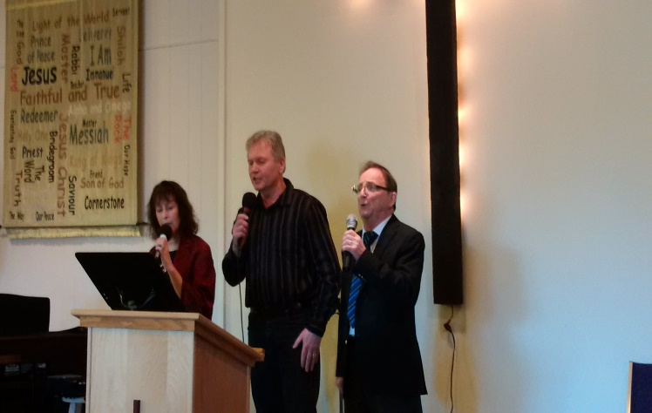
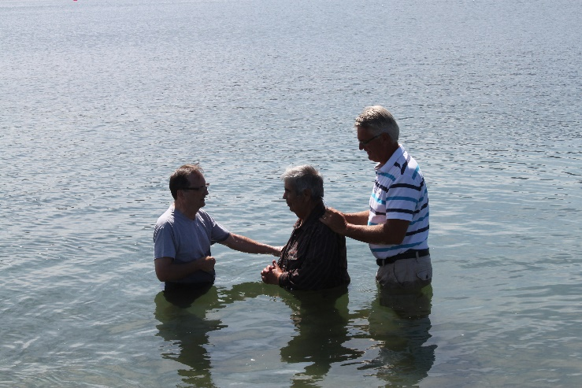
Wildwood Community Church
LPD Church of the Week
We so appreciate our District and the love and support of our Superintendent!
Pray For:
In January we began a new study/fellowship for the men we call "the Man Cave." Pray as we learn together and build relationships.
Upcoming Events:
We are Lord willing planning a showing of the film "The War Room " and studies on prayer to follow.
Pray for us as we seek God's will in refreshing and revitalizing.
Praise Points:
For a well attended ladies luncheon
22 Ladies came and enjoyed a great time of fellowship and spiritual encouragement.
For the unchurched Ladies who came

