Slide 1
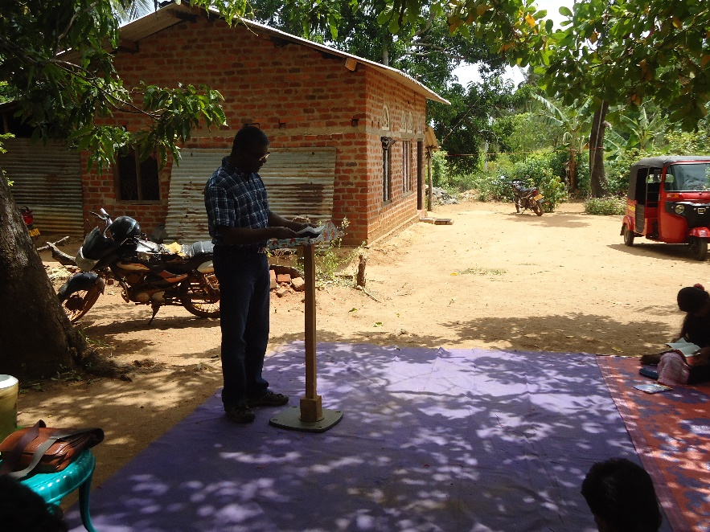
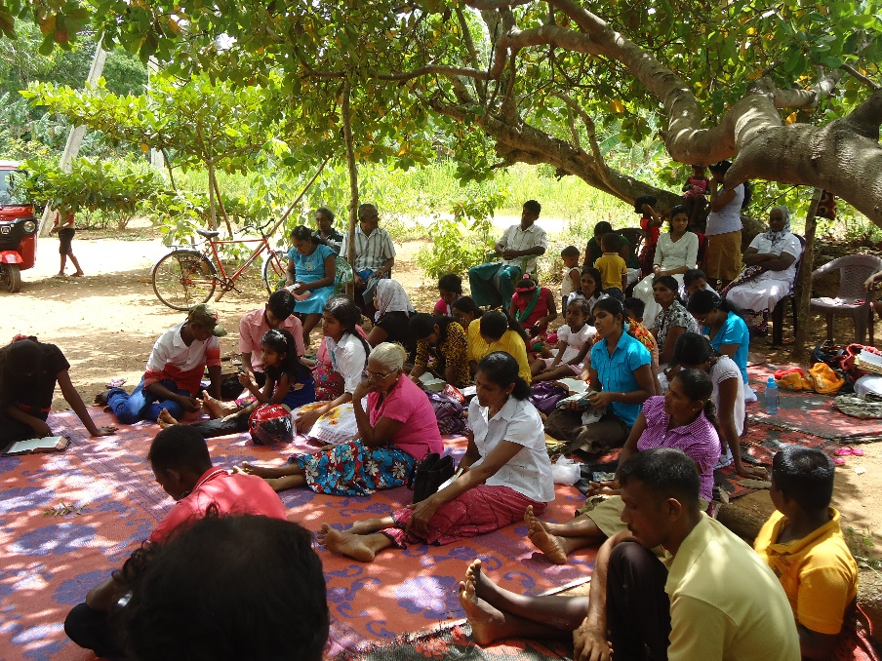
New Life International Fellowship
Prayer Requests:
Leadership and ministry of New Life for the Lord’s direction for future
Spiritual revival and commitment to the gospel in the fellowship
Upcoming short term mission trip to Sri Lanka – for a great harvest and church growth
Mission trip to Sri Lanka
LPD Church of the Week

