Slide 1
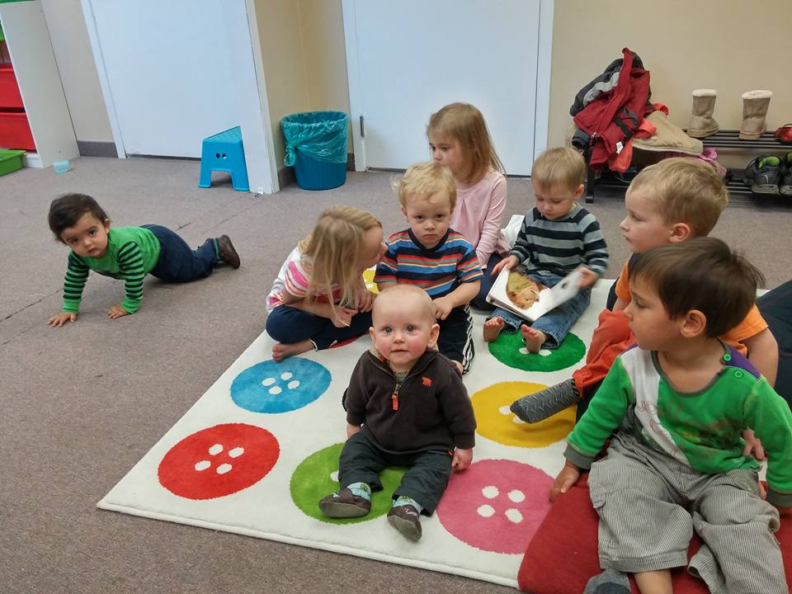
New Westminster efc
LPD Church of the Week
Prayer requests:
- ongoing transitions in leadership and ministries
- health & employment for many members in need
- a sense of hope and unity moving forward
Major Events:
- celebrated 75th anniversary over Thanksgiving 2015 weekend
- upcoming Easter service & service in Queen's Park (summer)
Praise points:
- reaching community through "Mom's in Prayer"
gathering and life groups
- new opportunities with "bread ministry" and International Students
- new members & deacons elected at year-end
- blessed to have Pastoral Intern (Henry) with us

