Slide 1
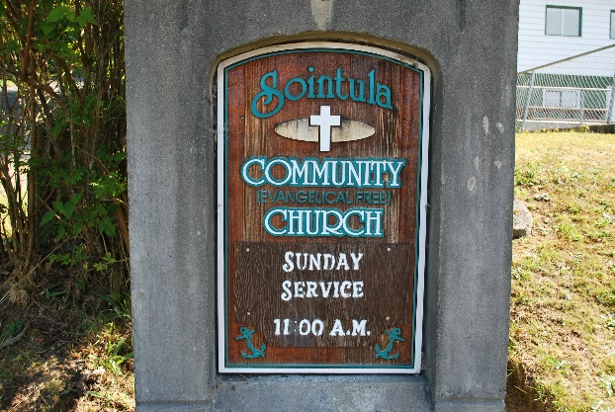
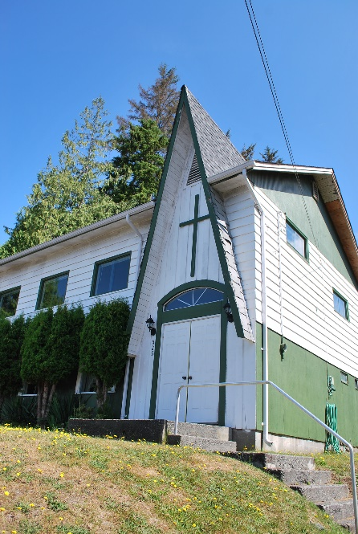
Sointula Community EFC
LPD Church of the week
Prayer Requests:
We have been going through a very difficult time as a congregation heath-wise over the past number of months
We continue to trust the Lord for opportunities to show His love to our community - that we might be a light in the darkness
Praise
We recently had the joy of celebrating a baptism together!
In the midst of our recent health problems, we have seen God's hand at work in exciting ways

