Slide 1
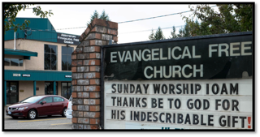
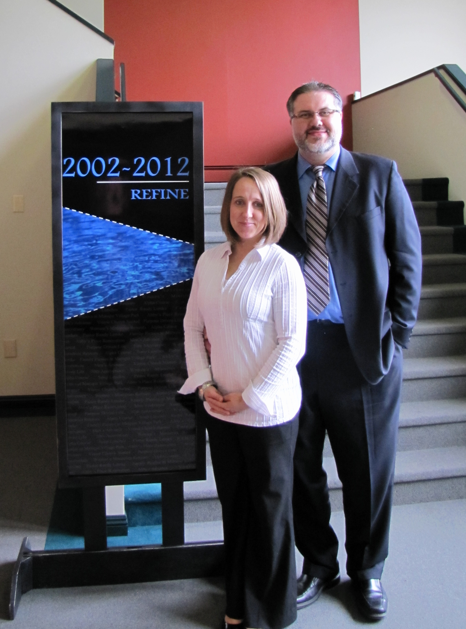
Abbotsford EFC
LPD Church of the Week
Please pray for AbbyFree as we gear up for Easter, this special time of reaching out to our neighbours with the Gospel!
This year, we are looking forward to a week of Easter Celebrations at AbbyFree Church, from Palm Sunday through to Easter Sunday.
Invitations have gone out for a Family Movie night Monday, March 21.
Maundy Thursday we’re having a Service of Prayer and Communion.
Good Friday and Easter Sunday Services are at 10 a.m., and Saturday we are having our Easter Extravaganza! This year we’re preparing for 500 people with food, games, crafts, the Easter story and an Easter Egg Hunt!
Senior Pastor Randy and Allana Lemke

