Slide 1
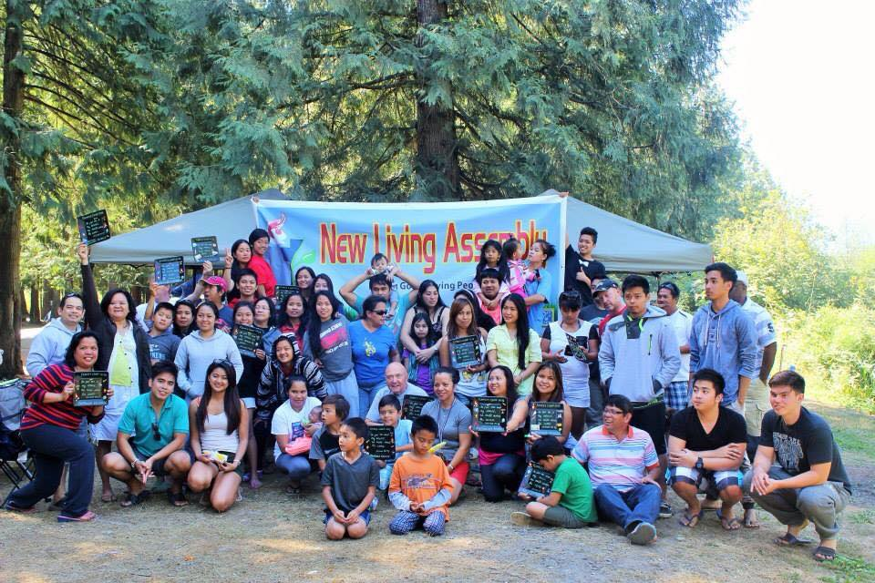
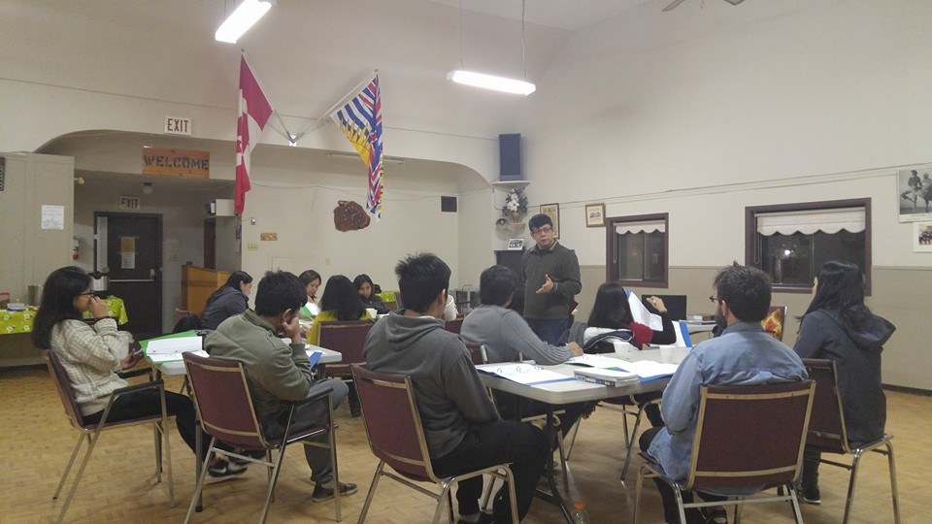
New Living assembly
LPD church of the week
We praise God for the launch of our NLA School of Ministry held every Saturday and Sunday, as we Pursue God’s Vision of Discipling His People.
We are excited to see the people learning and growing in their walk with the Lord and growing in passion to win the lost.
Prayer Requests:
Please pray for our Easter service celebration (He Is Risen)
Also for evangelism after the Easter celebration (practicum of NLA students to share Jesus)
Pray for growth
Pray for our application with CRA, to function as a member church of the LPD

