Slide 1
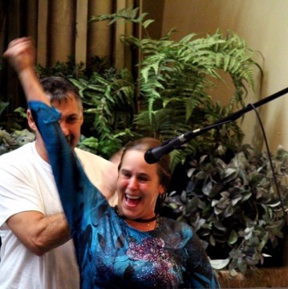
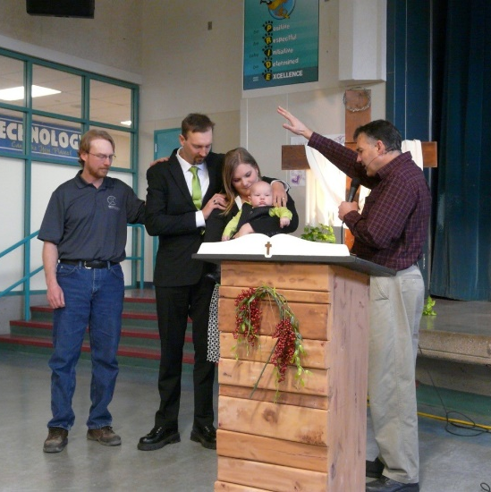
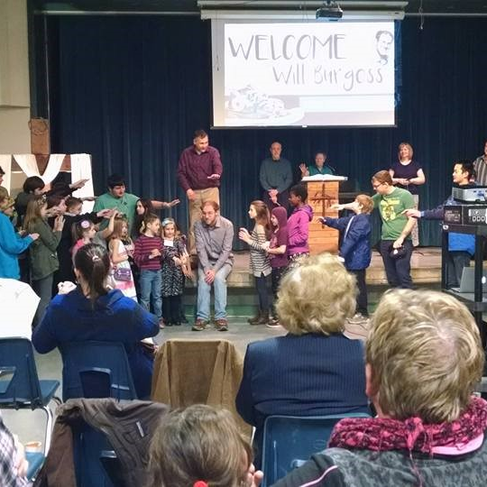
Mountain view church
LPD Church of the Week
Praise Points: Praise God for our new Youth Pastor, Will Burgess
Thank you for new members
Praise God for an awesome Men’s retreat in partnership with Abby Free EFC
Thank you for the desire for God’s Word and Holy living in our Church
Prayer Requests: New Church building/Office space
Greater hunger for the Spirit of God in everyday life
Greater impact on our community for Jesus

