Slide 1
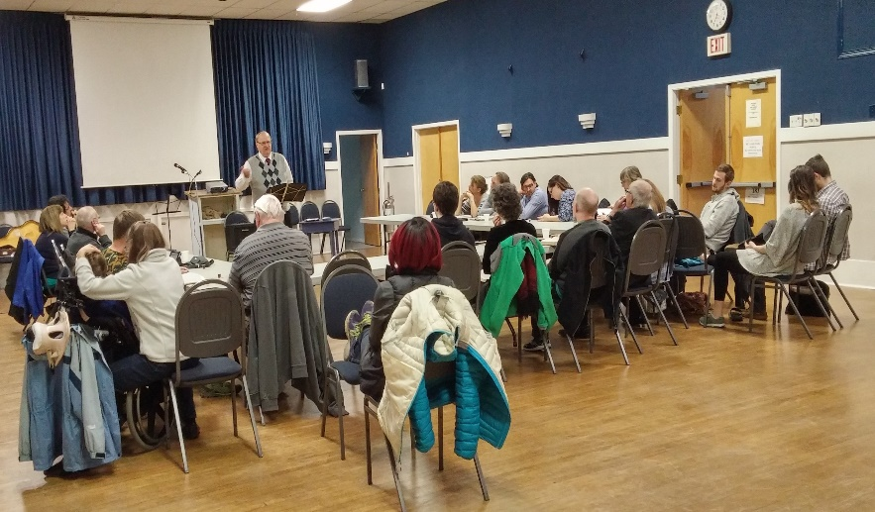
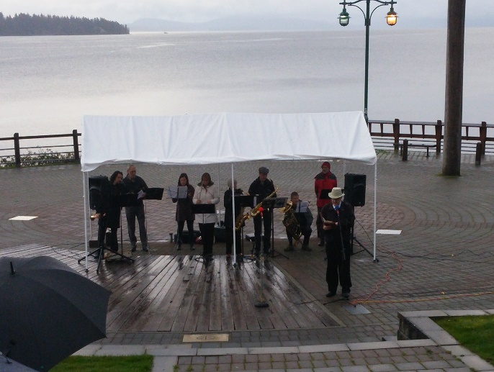
The Rock Christian Fellowship
Evening Service
Easter Sunrise Service
Church of the Week
Praise Points/Requests:
Praise for the annual Ladysmith Celebration of Light fundraiser raised over $8000 for the Ladysmith Soup Kitchen
Please pray for continued unity, blessing, and the Lord's guidance in all we do.

