Slide 1
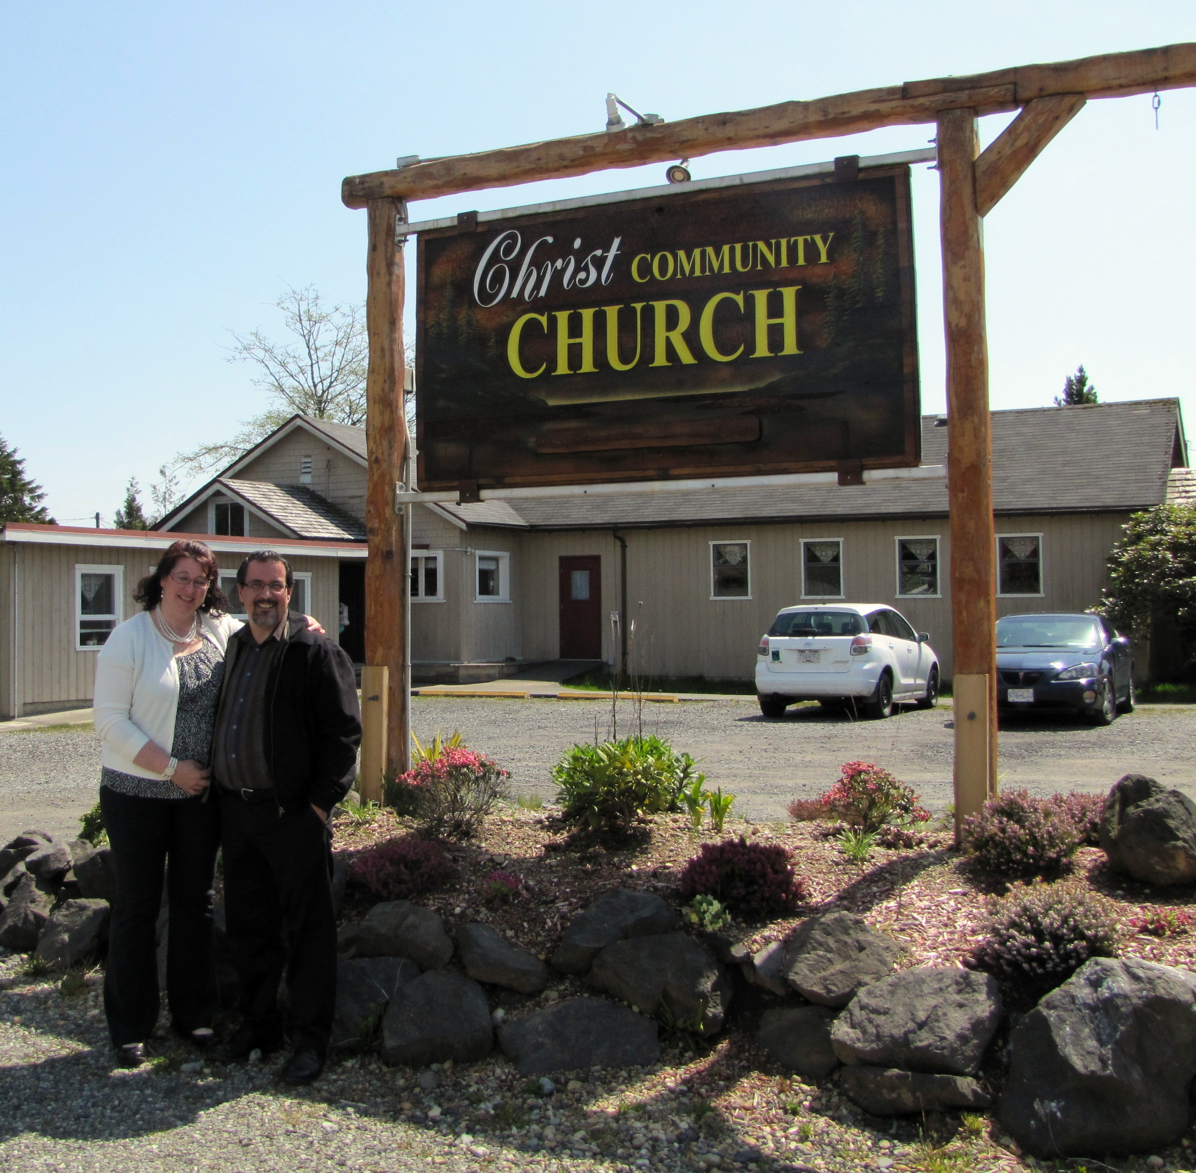
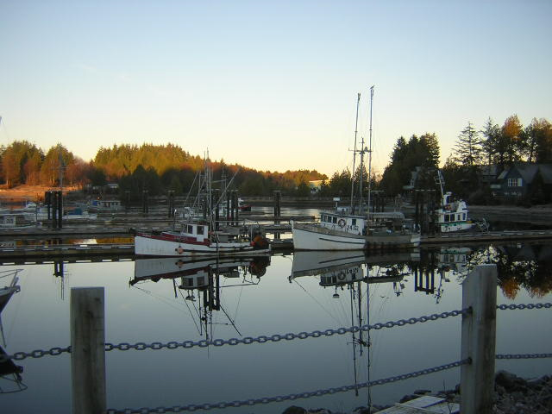
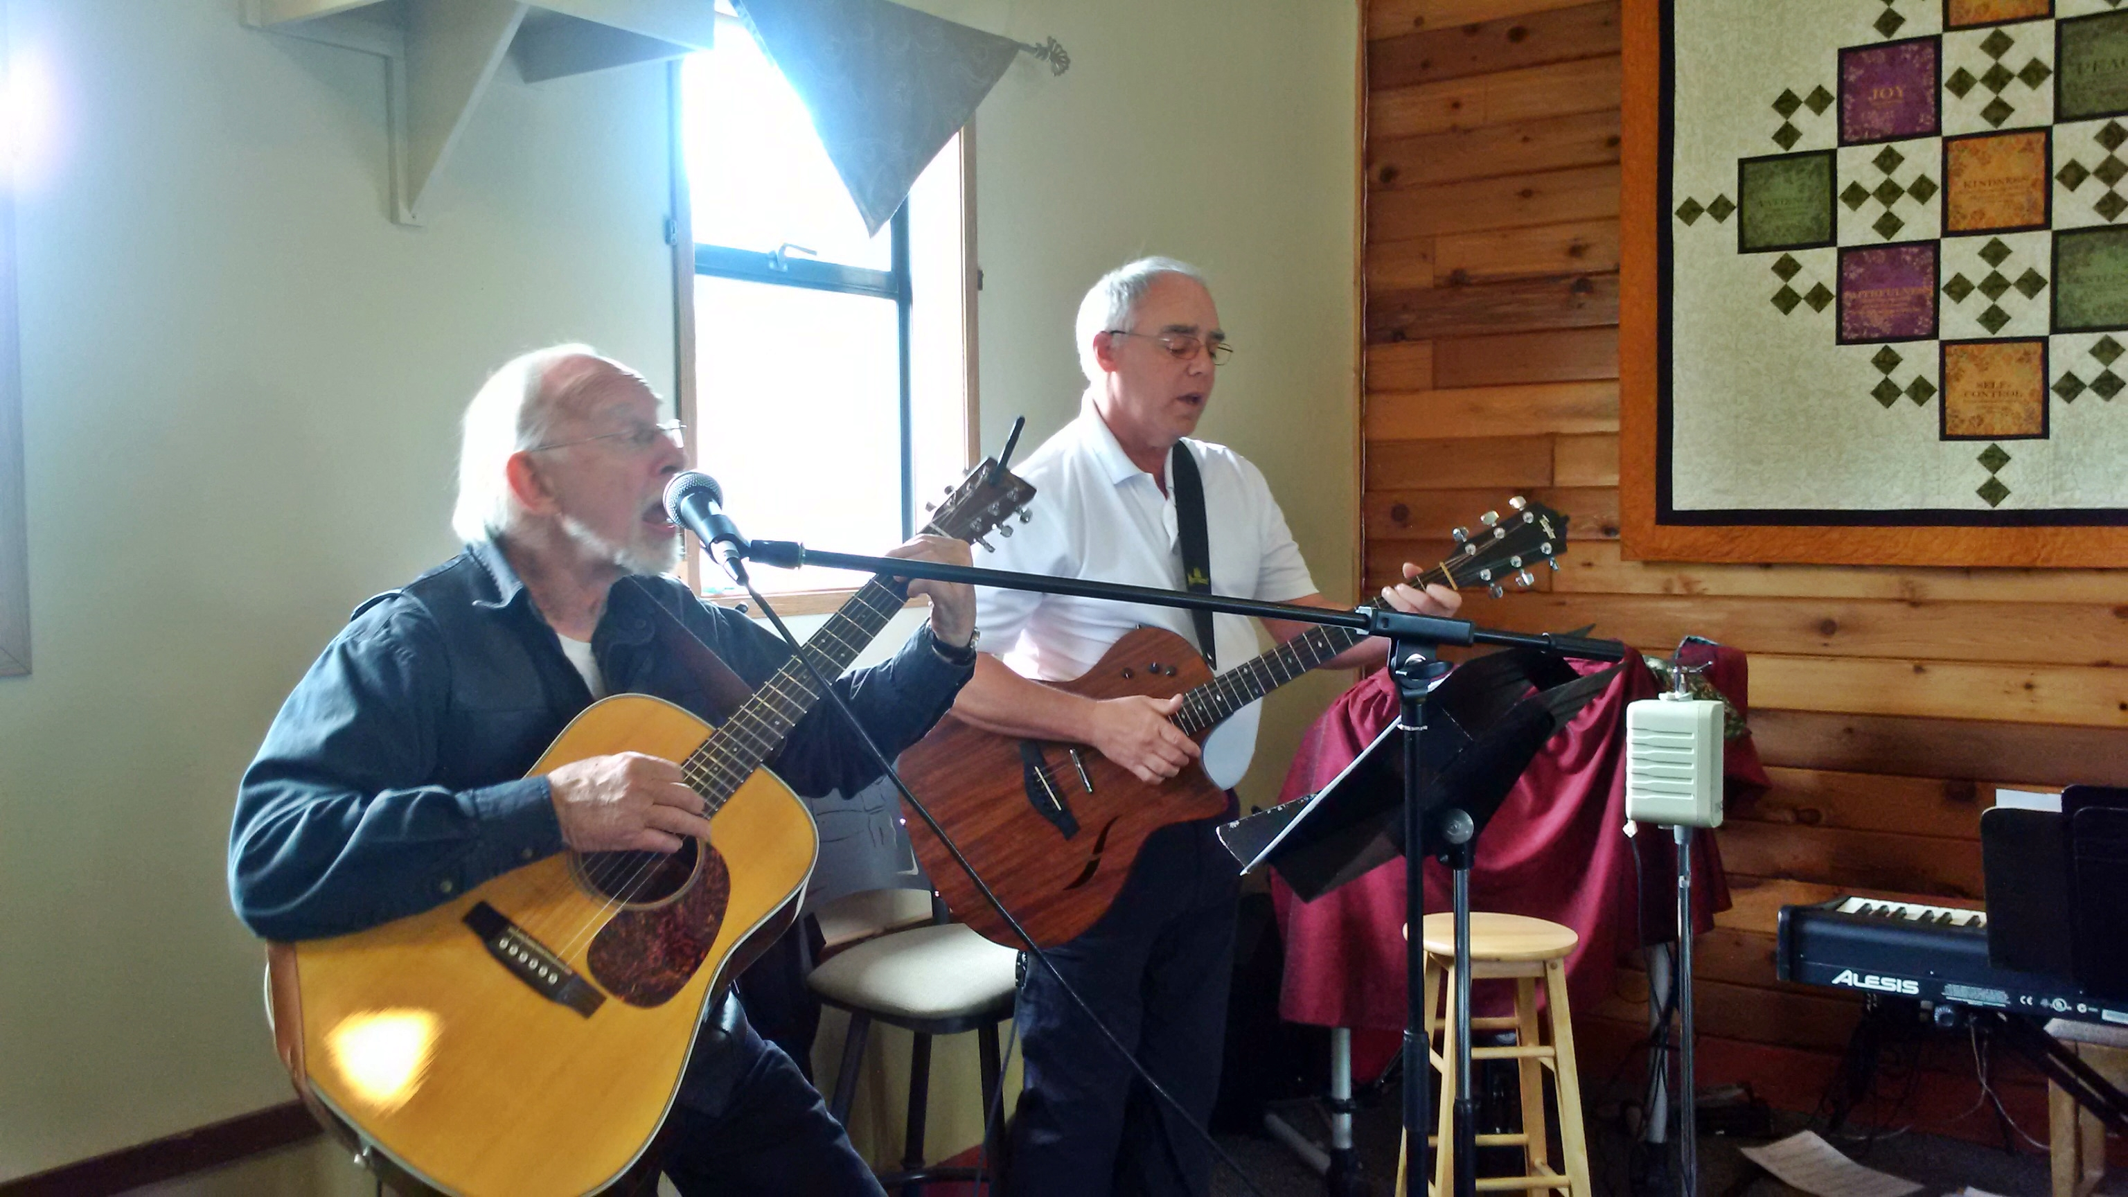
Christ Community Church
LPD Church of the Week
Please pray for:
The outreach to the community of Ucluelet and to the many visitors to the West Coast.
Summer ministry programs and opportunities.
Church Chair Chris (Maggie) Bird and the Elders as they provide leadership.
For Pastor Miles and Lorie White, who are on temporary leave.

