Slide 1
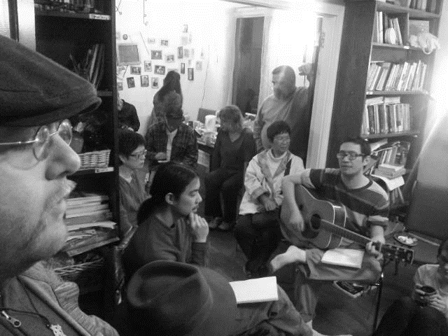
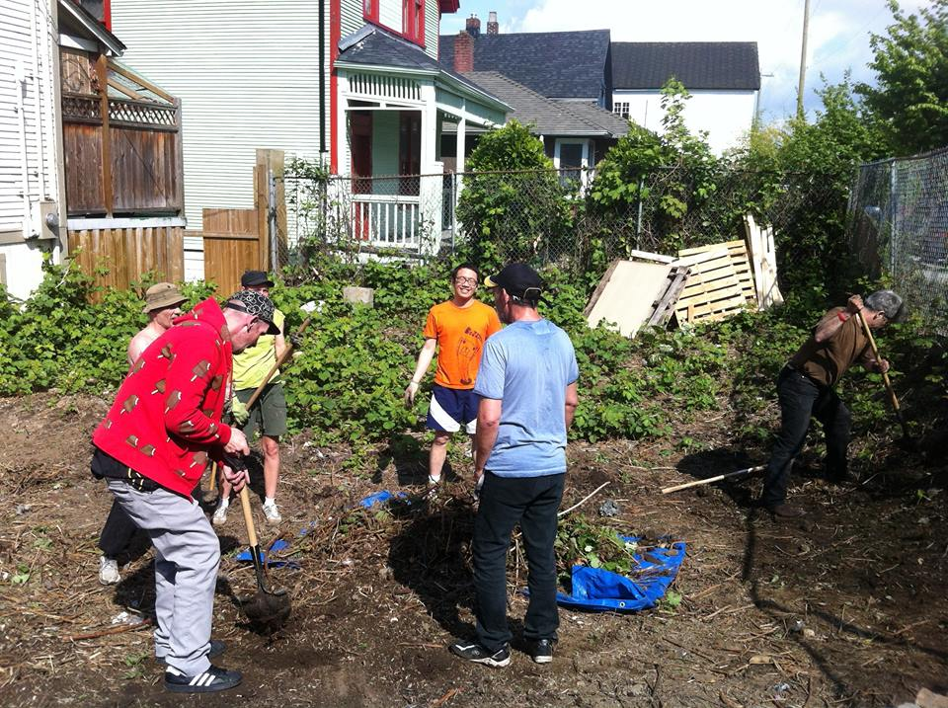
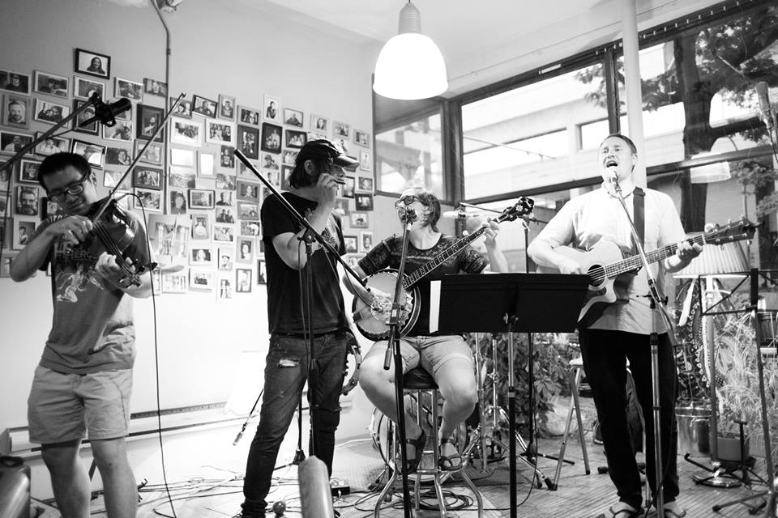
Servants Vancouver (Jonathan Ng)
LPD Church of the Week
Prayer Requests:
More workers for the harvest to work towards shalom in the Downtown Eastside
More churches to engage the Downtown Eastsides of their neighbourhoods
Our neighbours to experience an abundant life in Jesus
Ministry Philosophy - “seeking the shalom of the neighbourhood”
Emphasis on healthy, Christ-centred relationships and restoring the image of God in each person.
Community focus: we do things as a team, for practical and theological reasons.
Helping out while respecting each person’s dignity: People are our friends, not our clients.
In many ways, we are like family to people who have no family

