Slide 1
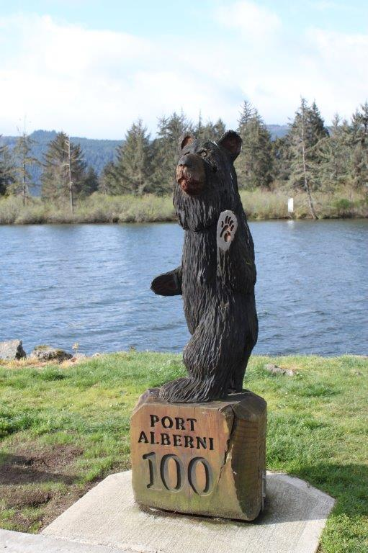
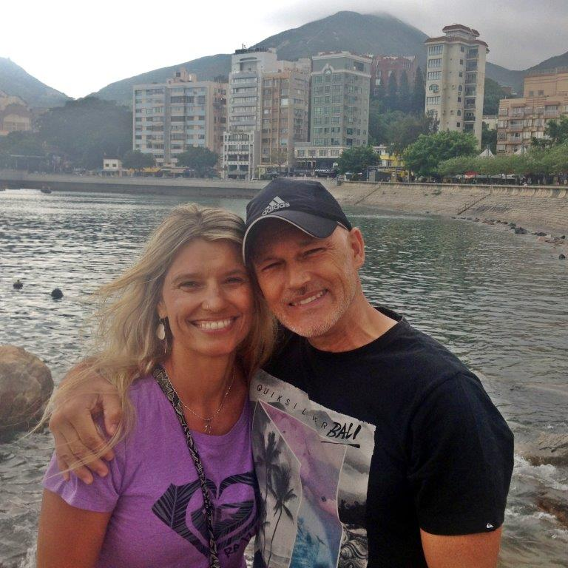
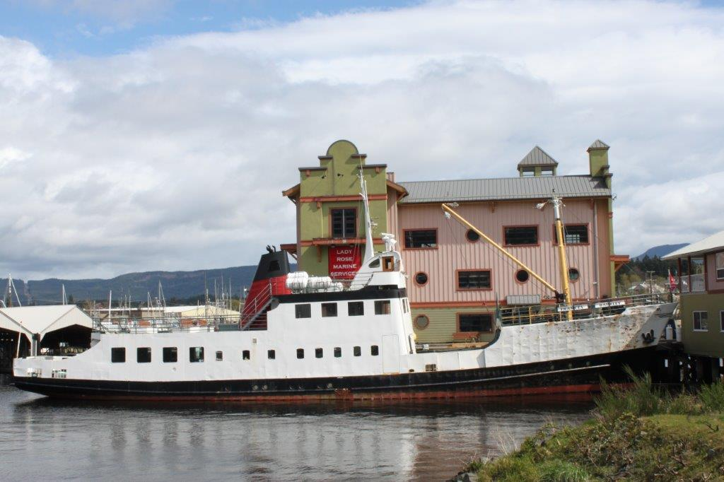
Port Alberni
LPD Missionary of the Week
Nori and Shelley Anderson
We are trusting God for a Core Group of at least 10 adults. Please pray that God will bring those folks to us as we land in Port Alberni at the beginning of August. Housing - please pray that He will lead us to the right home at an affordable price where our ministry will begin. Please pray that God will raise up not only prayer partners but financial partners who will journey with us as we trust God to bring this work to self-sufficiency in the next couple of years.

