Slide 1
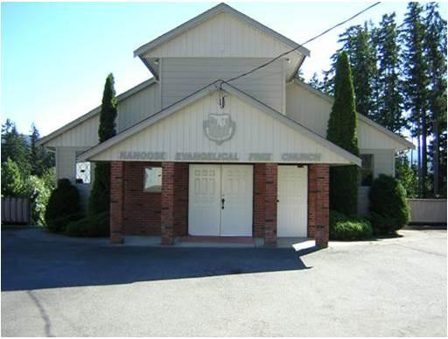
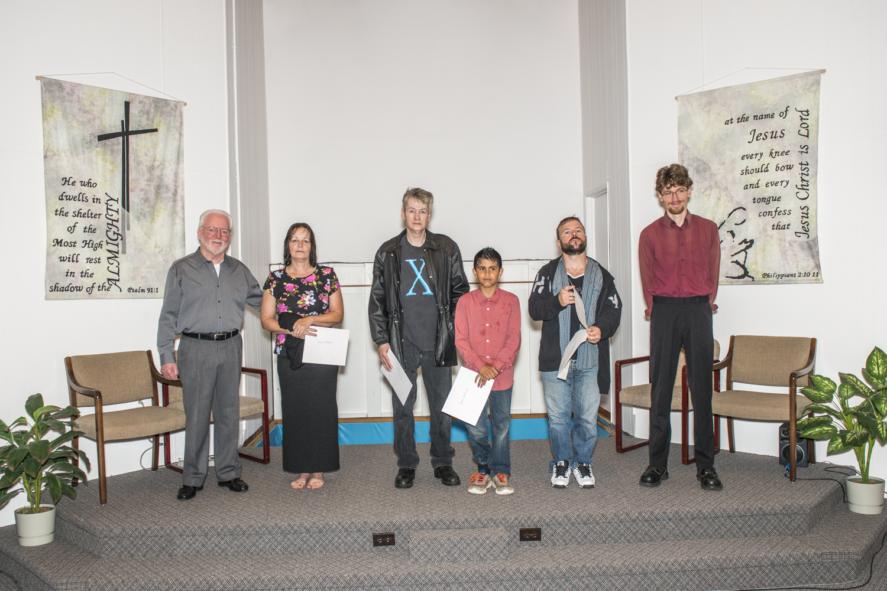
Nanoose efc
We praise the Lord for the four people baptized on Sunday the 19th. The youngest was 11 and the eldest 60! Please pray for Byron, Lynn, Tim and Gord and their continued growth in grace.
Two of our members just returned from a short term mission trip to Malawi.
Please pray for our continued ability to support our various missions in Pakistan, Madagascar, Ukraine, Zimbabwe, Uganda, South Africa and the Philippines.
We are thankful to our ladies sewing group which is heavily engaged in making clothing sent to various missions
Lpd Church of the week

