Slide 1
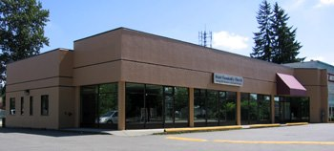
Grace Community Church
LPD Church of the Week
Please join in prayer for:
Pitt Meadows Day Saturday 4th June
10 years of outreach to the community through free hot dogs/chips/drinks after parade
Pray that God would use this outreach
The continued work of God in His people’s hearts
The 50 kids who attend Sunday School
Fellowship lunch held twice a month
Discernment as they face the issue of space
The welcoming and active church family who share in church ministry
Provision as they face the issue of a new roof

