Slide 1
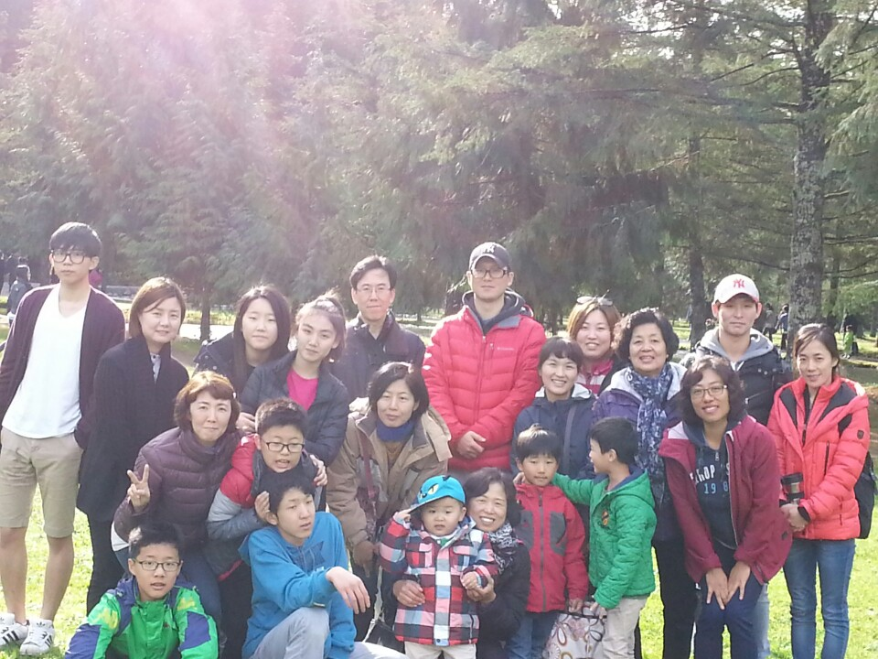
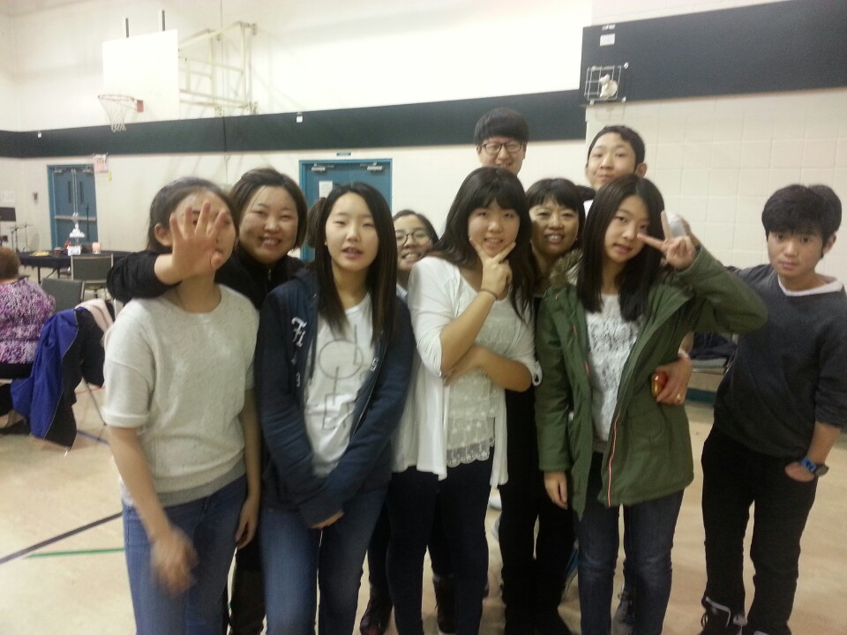
ABBOTSFORD VISION CHURCH
LPD CHURCH OF THE WEEK
This church was planted in partnership with and on the site of Abbotsford EFC in 2007, and ministers to Korean-speaking immigrants in the Abbotsford region.
Please pray for Pastor James (Gloria) Koo, and especially for Abbotsford Vision Church to grow more to do His work for God's Glory.

