Slide 1
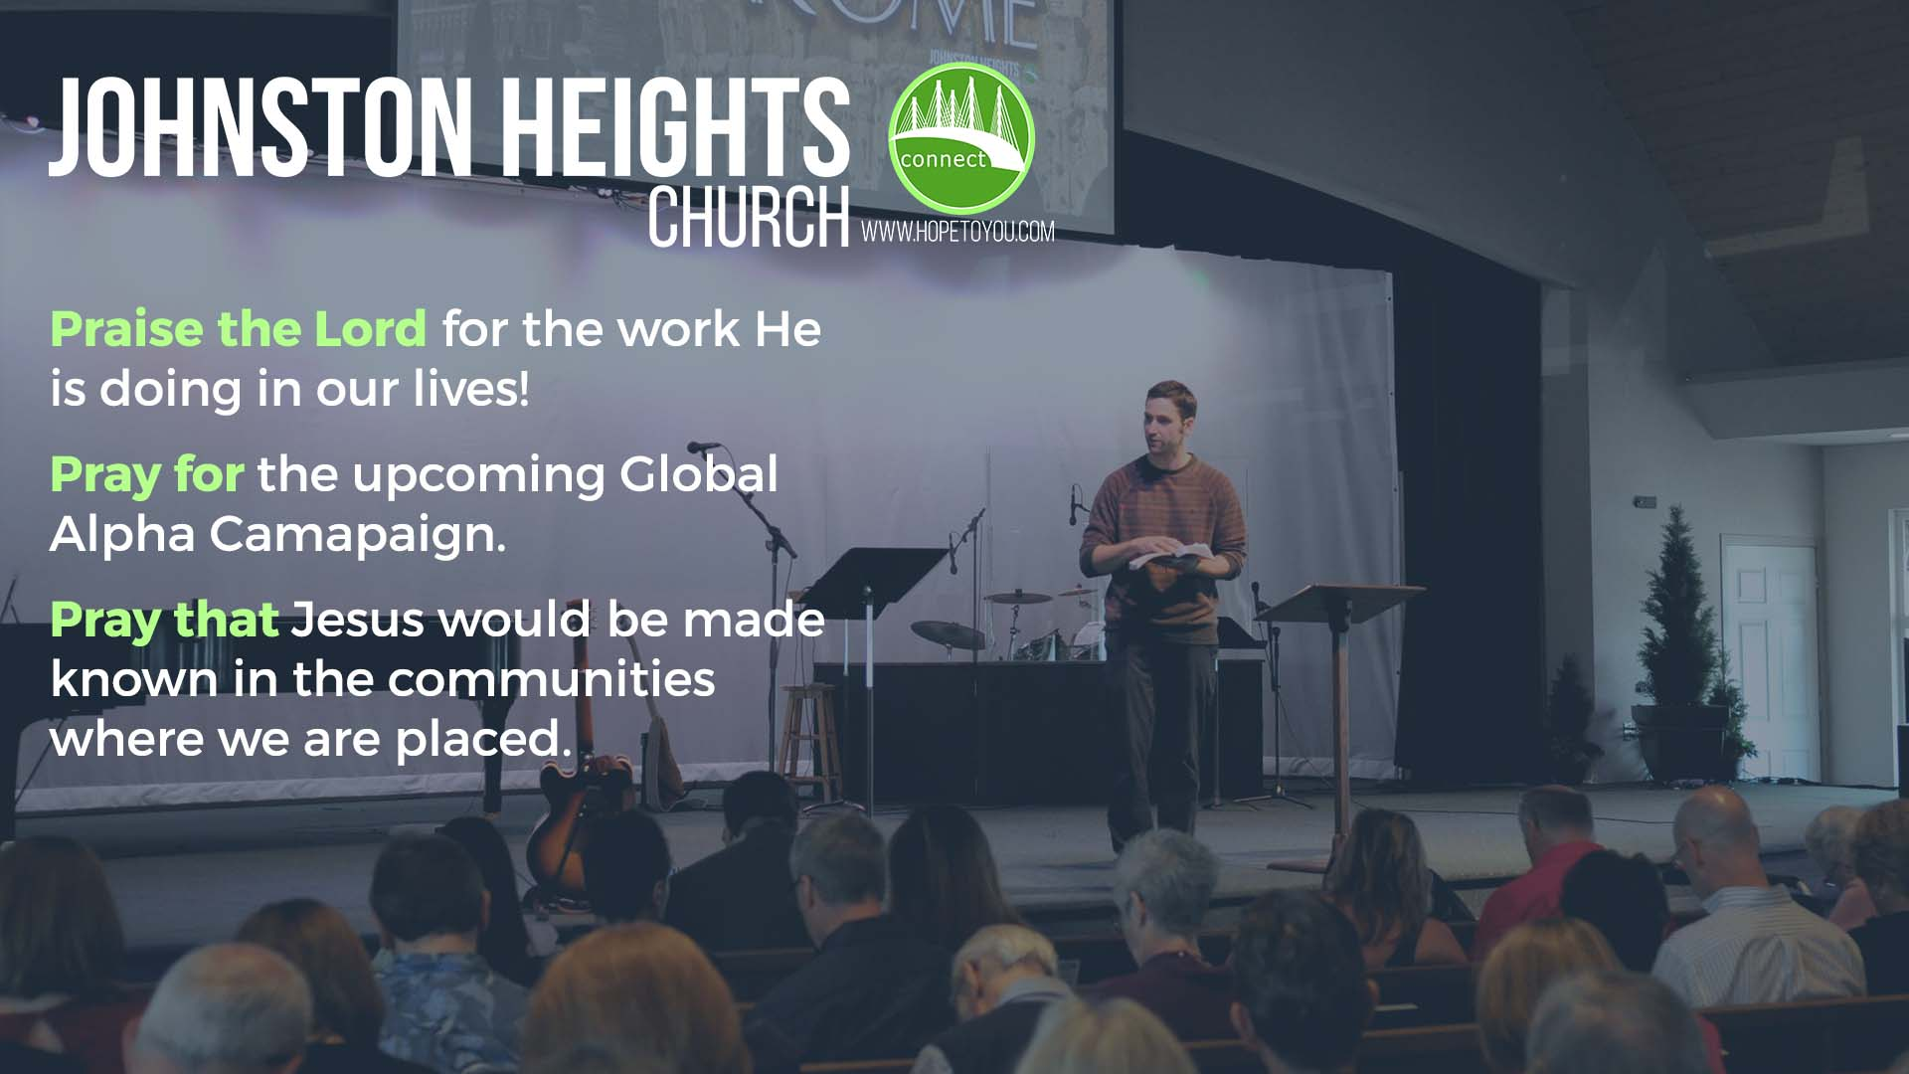
LPD Church of the Week
Alpha Campaign.

