Slide 1
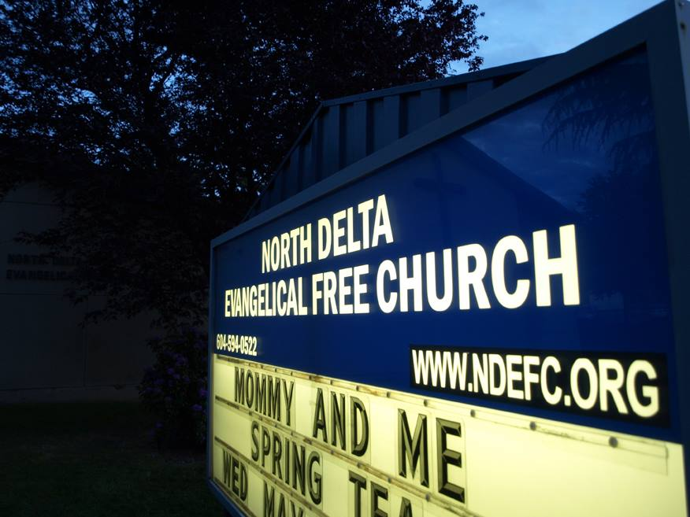
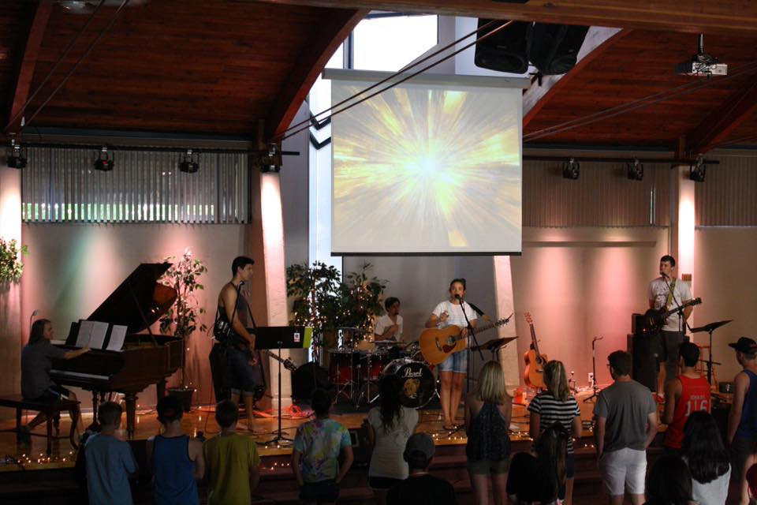
North Delta EFC
LPD Church of the Week
Pray for the many church outreach activities that will start up again in the next few weeks, and the church leaders as they seek to pursue the heart of Jesus in our community. Praise God for the many youth that participated in Explosion, a week of worship and outreach to our community involving service projects, guest speakers, group games and shared meals.

