Slide 1
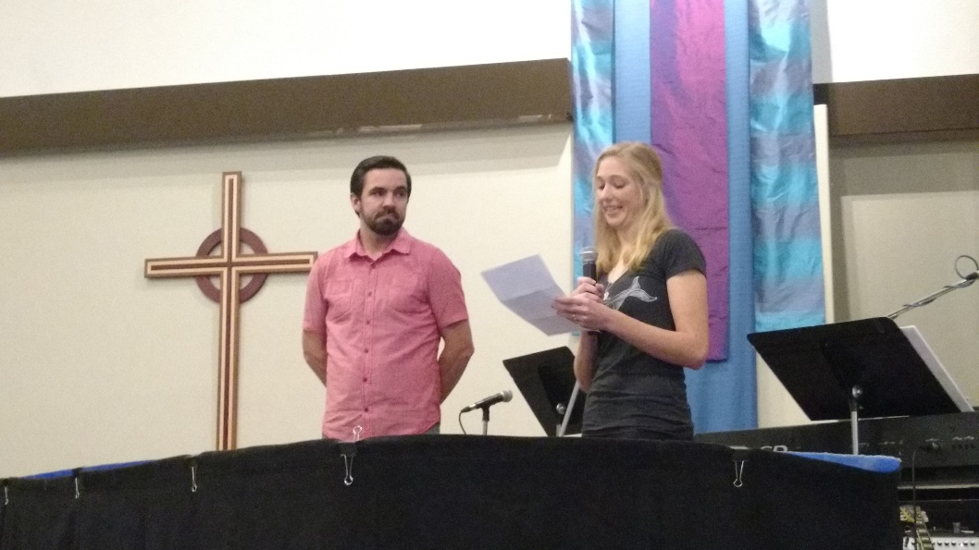
Fort Langley EFC
LPD Church of the Week
Praise God that we were able to host a successful EFCC conference! God’s presence was felt in the worship, the teaching, the fellowship and the time together!
Praise God that we recently had a number of baptisms and baby dedications as we celebrated life together.
Pray for our church as we discern God’s leading for the fall and beyond, particularly in the area of worship ministry.
Praise God that our youth were recently able to enjoy time out at Cultus Lake together!

