Slide 1
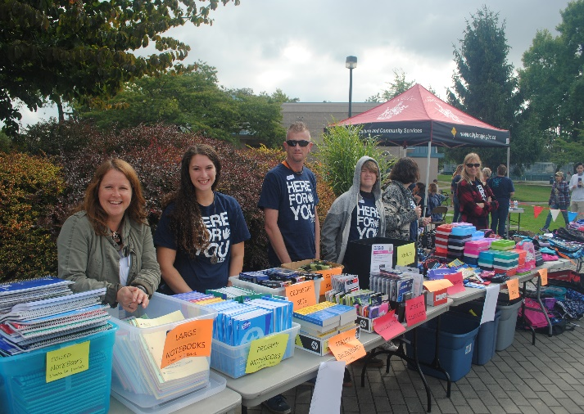
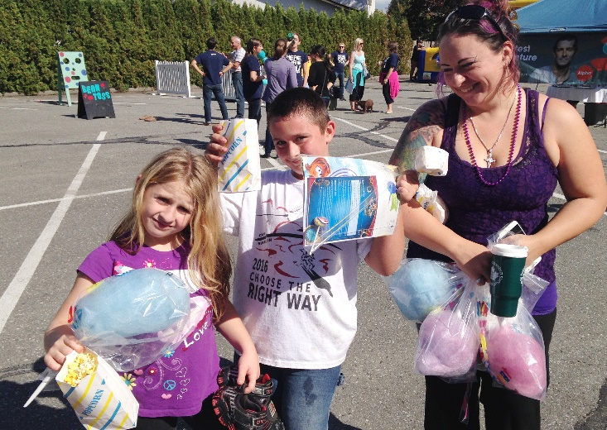
Langley EFC
LPD Church of the Week
Labour Day weekend we took LEFC to the park, where we had an awesome church service, followed by a Back to School free store. More than 200 families stopped in for supplies and hair cuts!
Kick off Sunday we invited the neighbourhood to church followed by a big Block Party. A highlight was seeing families return from the Back to School Free Store a couple weeks earlier.

