Slide 1
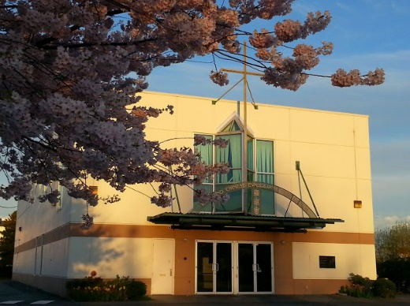
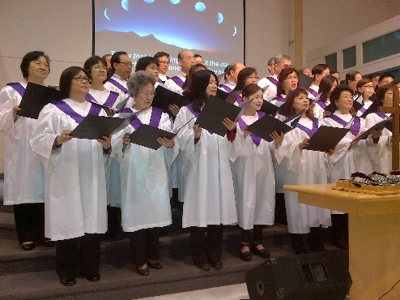
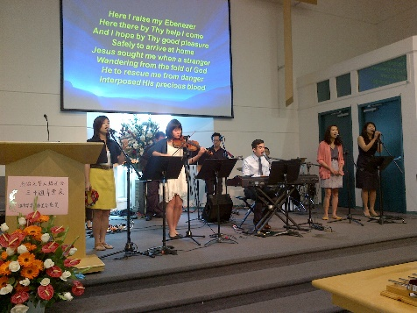
Richmond Chinese EFC
LPD church of the week
1. RCEFC celebrates our 33rd anniversary on Sept 11. Praise God for His provision and guidance throughout this time.
2. Pray for the search for a Pastor of English Ministries.
3. Pray for the current pastors - Pastor Anthony Yeung (Lead Pastor), Pastor Kwok Yin Ho (Pastor of Chinese Ministries), Pastor Richard Franklin (Interim Pastor of English Ministries), asking God to grant them wisdom and strength for ministry at the church.
4. Pray for Church-wide Annual Missions Conference - October 23 with the theme "Opportunity on your doorstep" - speakers : Rev. Keith Lee, Peter Trinh.
5. Pray for God's guidance in deacons election at end of October.
6. Pray for various fellowships and AWANA, resuming in September after summer break.

