Slide 1
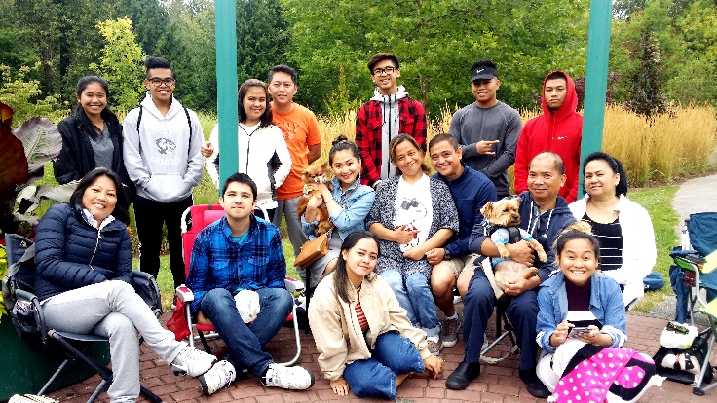
Jesus Is Our Salvation (JIOS) LPD Church of the Week
Praise and Prayer Points:
Praise for the continuous commitment of the remaining members of JIOS!
Pray for our evangelistic training that is going on every Sunday to equip all members in sharing the gospel.
Pray for our plan in committing to support The Wycliffe Bible Translator as part of our mission project.
Pray for us as we go to public places and apply what we have learned in sharing the gospel.

