Slide 1
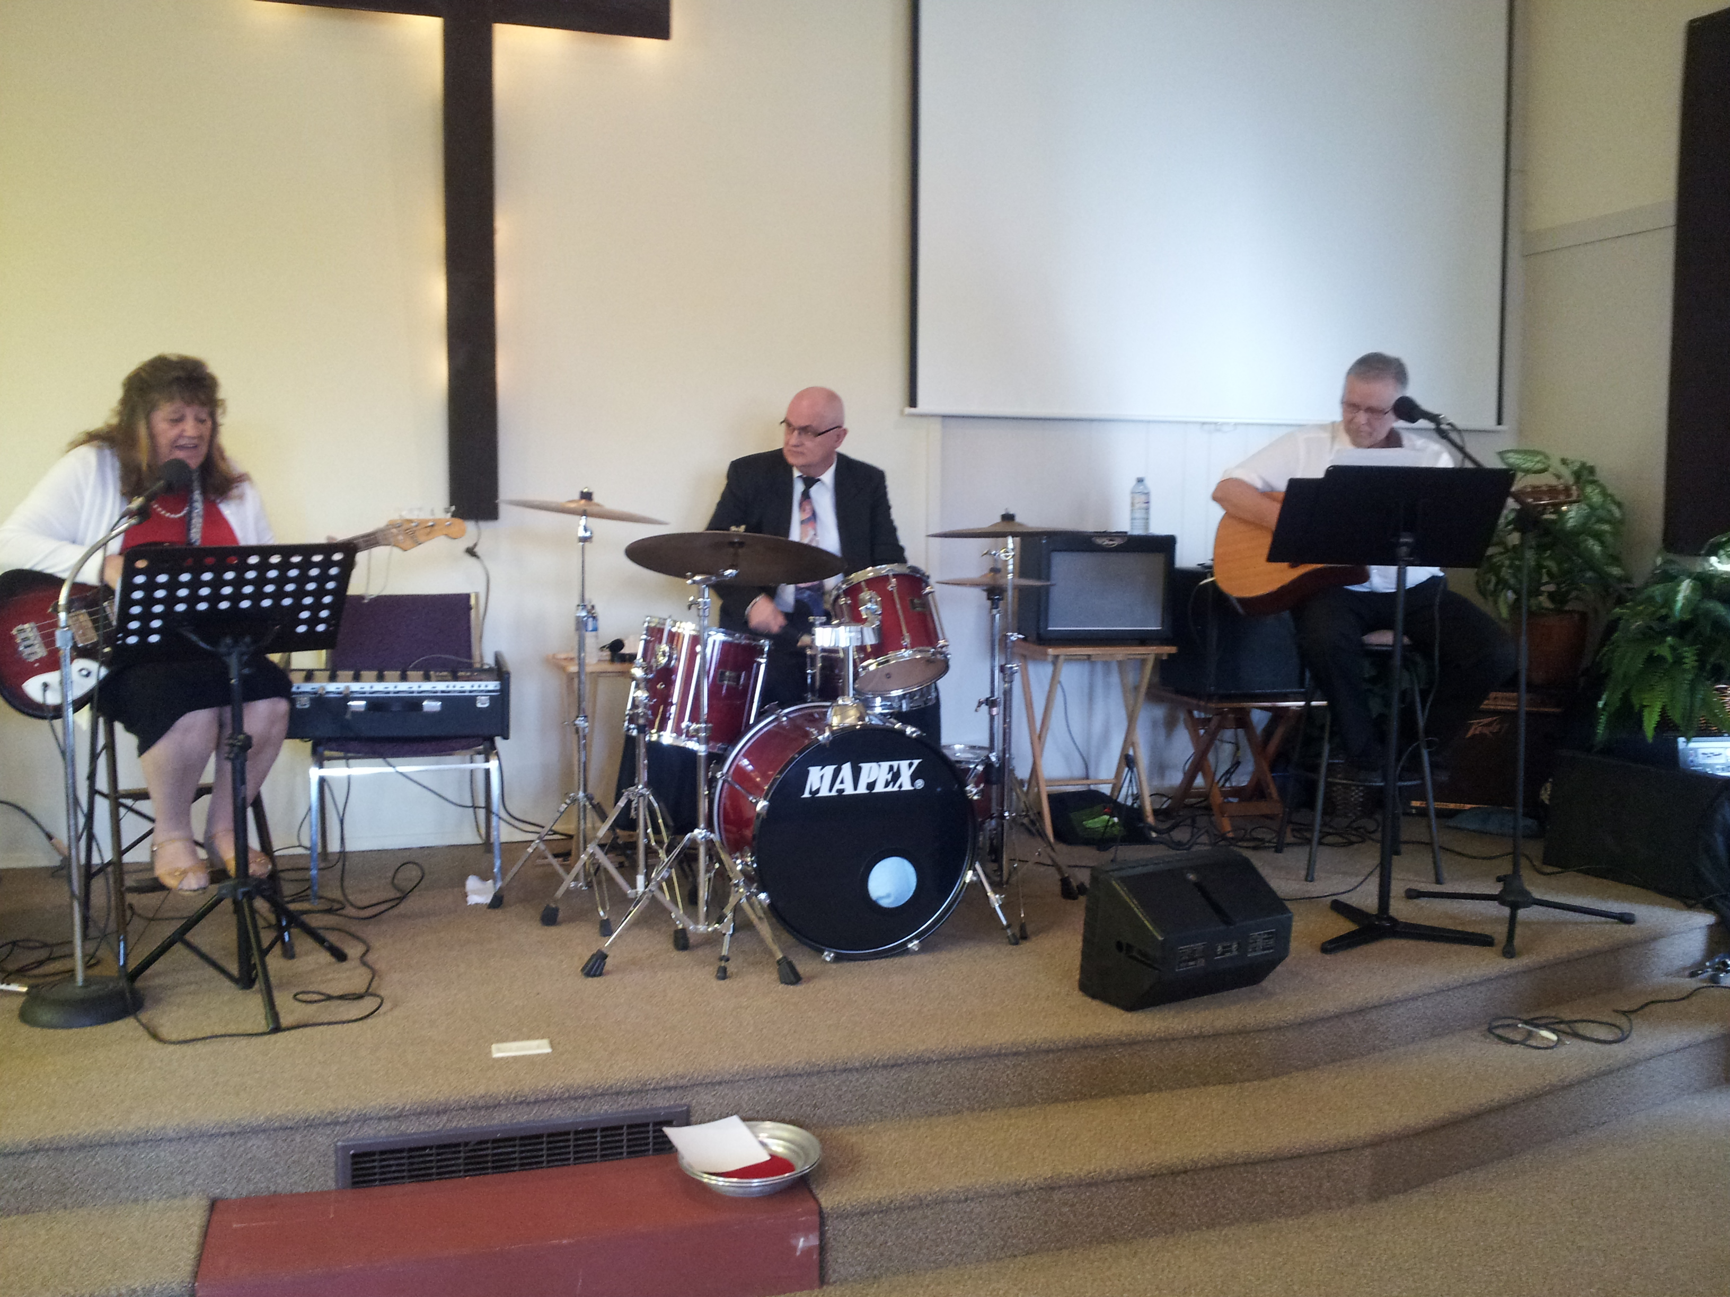
Wildwood Community Church
Our God is so good and we are very excited about what He is doing
here in Bowser.
Praise for:
Newcomers
Baptisms
Beginning a small study group in Parksville
We had opportunity to share Christ with a man of B’Hai faith.
Pray for the Holy Spirit to be at work in his heart.
Pray for the Holy Spirit to guide us.
Pray for the elderly and their challenges, and for God’s hand of healing.
Our recent church BBQ where we were excited to welcome our neighbours
We have just had Norrie and Shelley Anderson share their passion for Port McNeil with us and encourage all to join us in prayer for them.
"Sacred Harmony" with Joe and Mary Massop. Shelley's folks have ministered with us on several occasions this summer and at our BBQ. See the attached picture.
LPD Church of the Week

