Slide 1
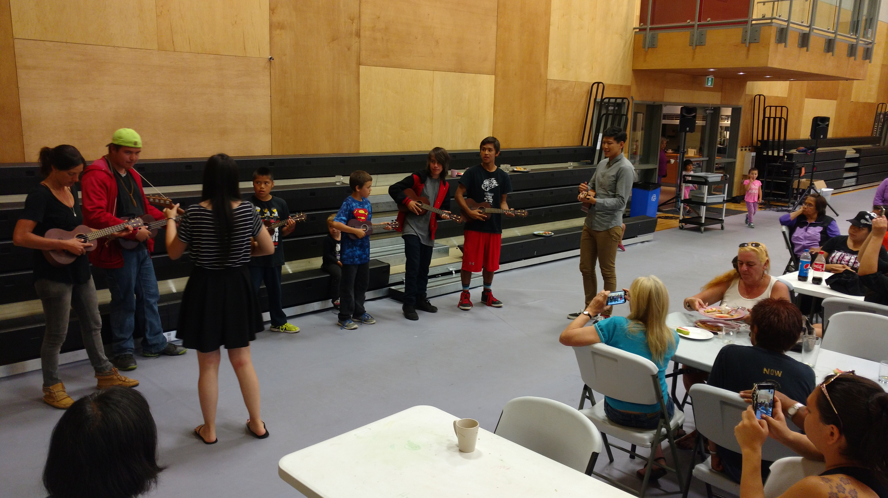
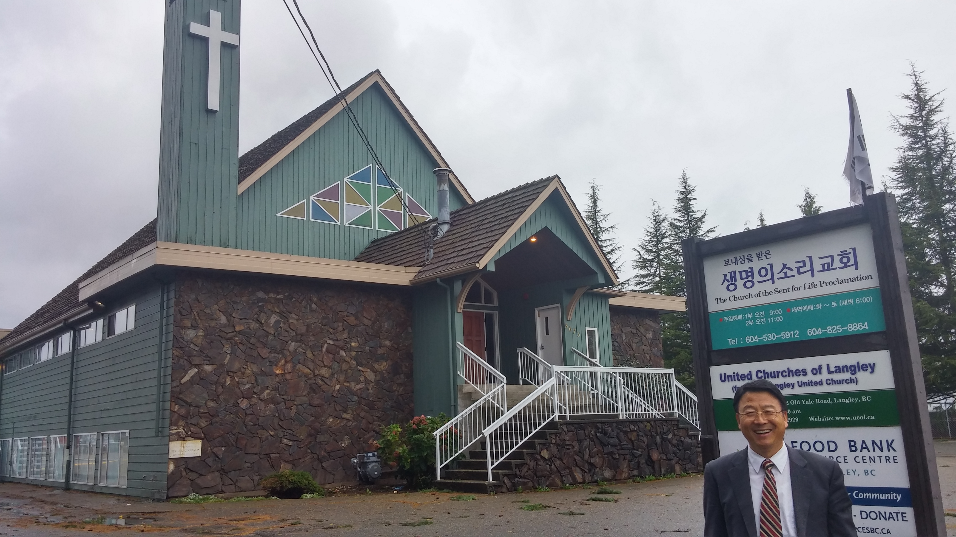
Church of the sent for life proclamation
Pray for the Friend Day on September 18, the 16th Anniversary of our church, which is an outreach activity, and for the church team and house group leaders who will start their ministry again beginning next week.
LPD Church of the Week
Pray for the purchase of the church building. Praise God for summer short mission in the reservation of Ucluelet First Nation, sharing the Gospel through cleaning the village, free music lesson, and concert with Korean dinner.

