Slide 1
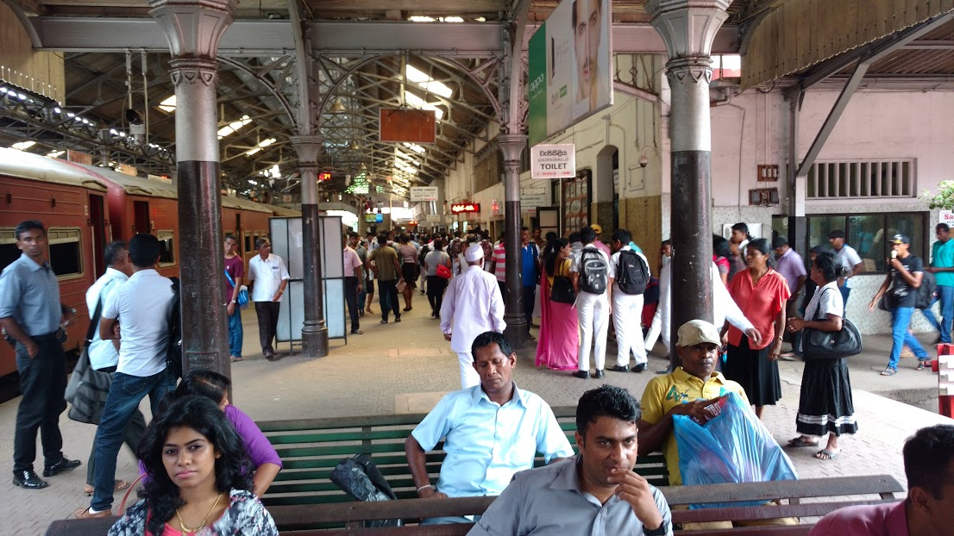
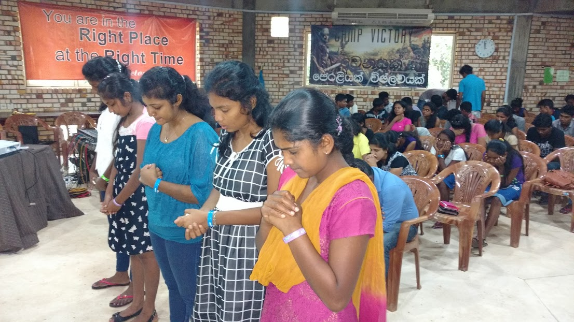
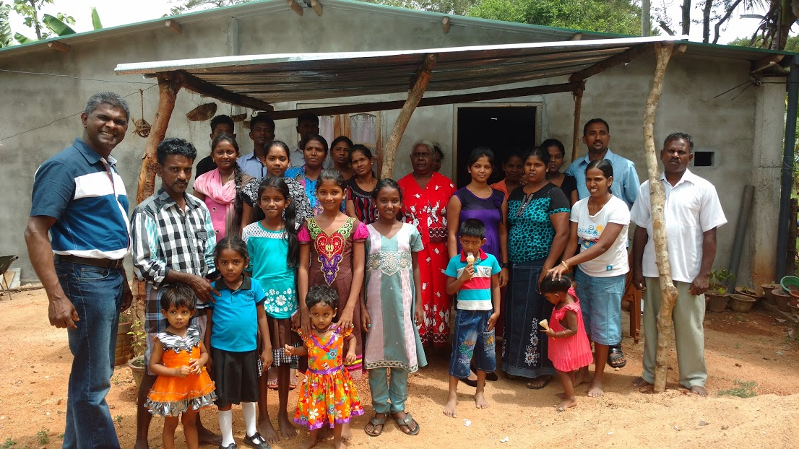
New Life International Fellowship
LPD Church of the Week
Praise Points:
Praise be to God for another successful mission trip to Sri Lanka in June this year
Thank God for the many souls touched by the power of the word of God during my mission in Sri Lanka
Thank the Lord for his faithfulness in meeting our family and ministry related needs
Prayer Requests:
For continued growth in New Life Fellowship ministry in Surrey
For leaders of the Fellowship for Motivation and continued support
For my ministry with the English congregation of Coquitlam Chinese EFC
For new opportunities to minister among the Sri Lankan families

