Slide 1
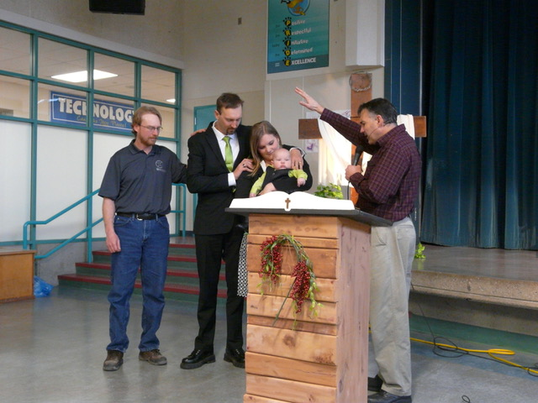
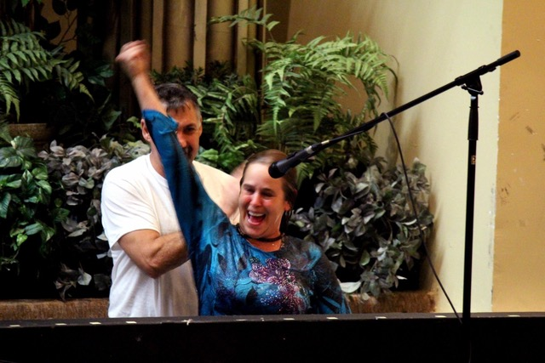
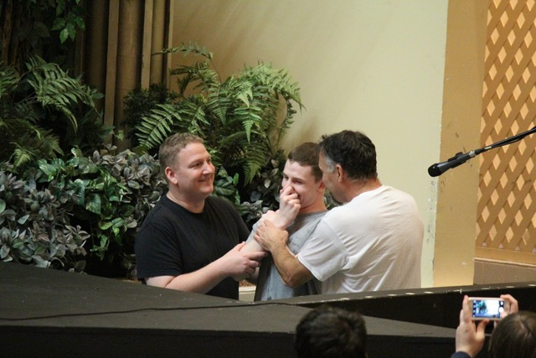
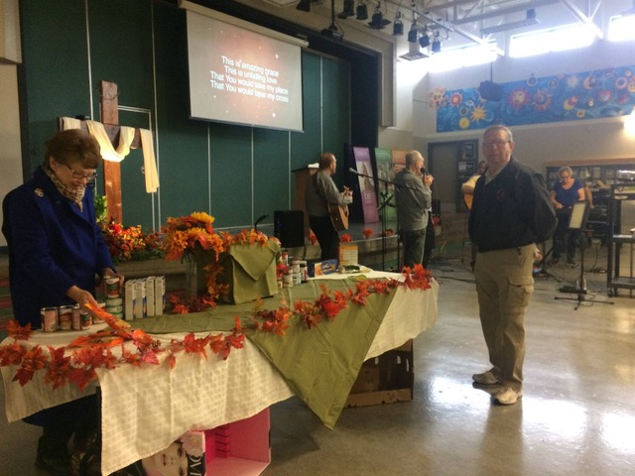
Mountain View Church
Please pray with us for:
God’s financial provision for the challenges ahead
Desire to walk more deeply with Jesus
Wisdom and a sensitive ear to the Spirit for the year ahead
We praise God for newcomers to our church and growth in our youth ministry, as well as our new youth pastor and for our vibrant church!
Events:
We have just celebrated Thanksgiving and were able to collect a large amount of food for the food bank
We look forward to a Soup & Chilli potluck on 6th November
We have an exciting Christmas series called “The Journey” planned that will end with a Christmas Banquet & Service on Friday 23rd December
LPD Church of the Week
Mountain View Church

