Slide 1
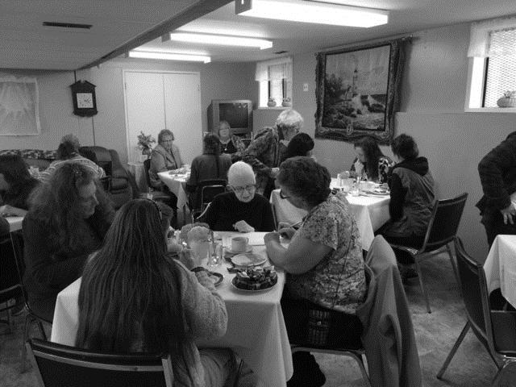
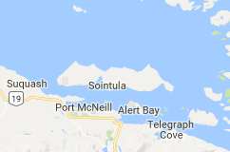
Sointula Community Church LPD Church of the Week
Praise God for a good turn out and a wonderful time of food and fellowship at our recent Ladies Harvest Tea!
Praise God for the many who came out and helped us prepare 35 apple pies for the upcoming Sointula Winter Fest
We are thankful for the opportunities that God continues to provide to reach our community with the good news of Jesus Christ!
Please pray with us that He will use our church to further His kingdom here.
Sointula is located on Malcolm Island and pastored by Ben and Anna Crumback

