Slide 1
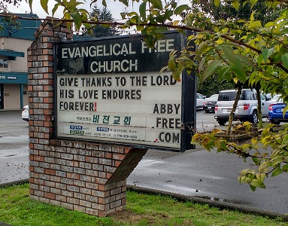
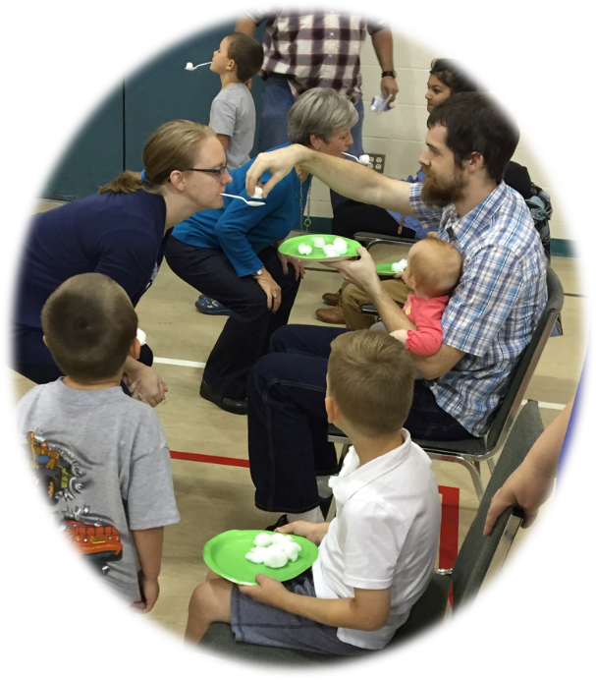
Abbotsford EFC
Prayer For:
1. Good attendance at Village Kids and Village Kitchen outreach ministries starting up Oct 6.
2. A good response to the World Relief presentation on Thanksgiving Oct 9.
Praise For:
1. A good turn out at our Annual Fall Picnic held September 18.
2. The many babies and children in our Sunday morning AbbyKids and AbbyTots
3. A good report, turnout and participation at our AGM last week.
Fall Picnic held in the gym due to poor weather
LPD Church of the Week
The churches in Abbotsford are getting together to communicate a common message

