Slide 1
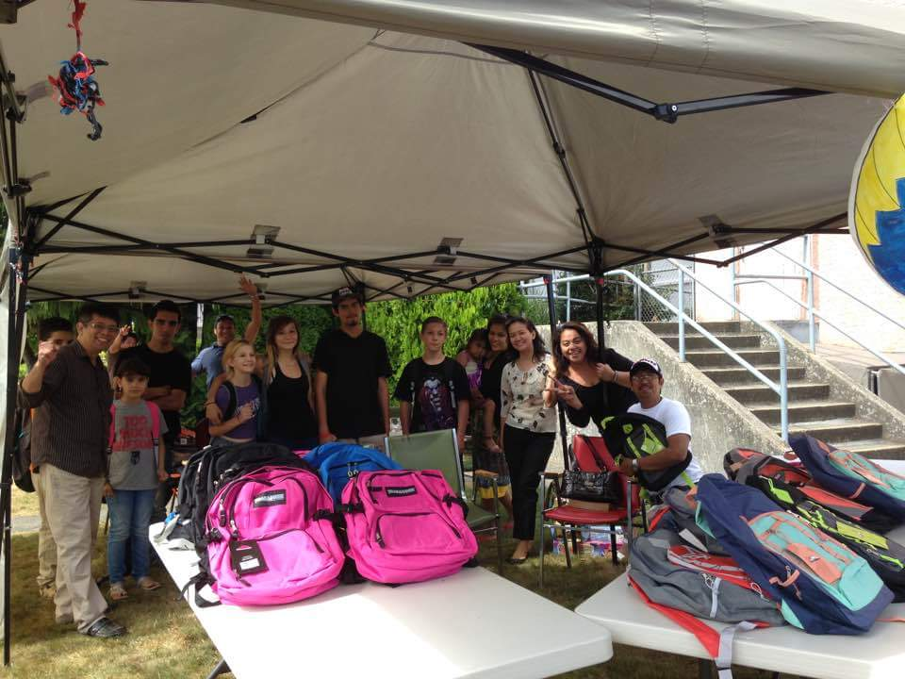
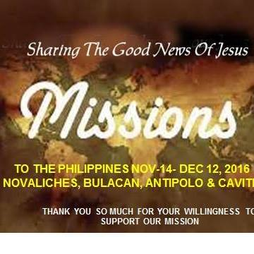
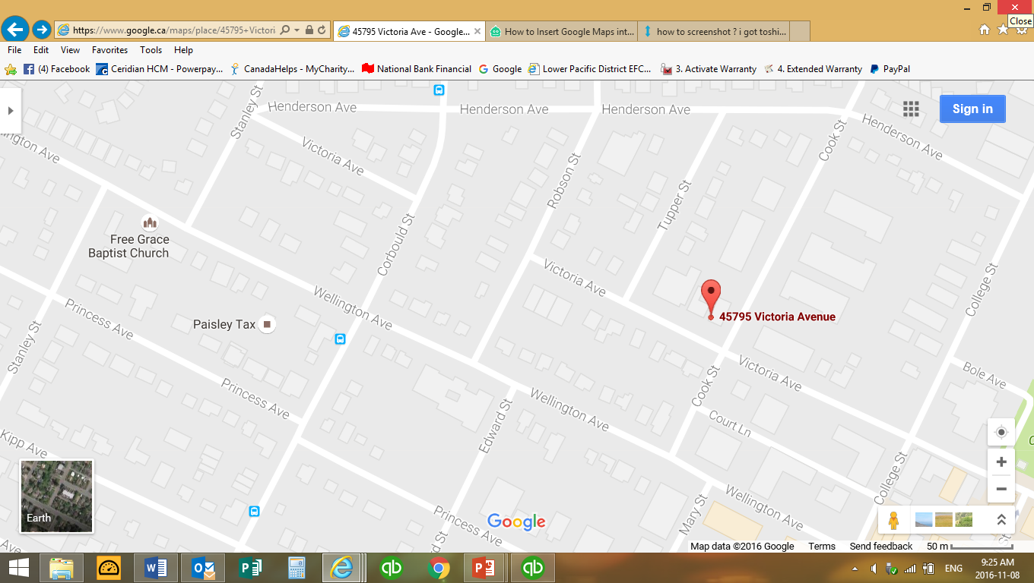
_{New Living Assembly}
_{LPD Church of the Week}
Please pray for:
Our Mission Trip to the Philippines
The Leadership
The spiritual growth of the church
Praise God for the support of backpack giveaways
New Living Assembly meets at the Senior Social Society in Chilliwack and is pastored by Noel and Lynda Macasaet

