Slide 1
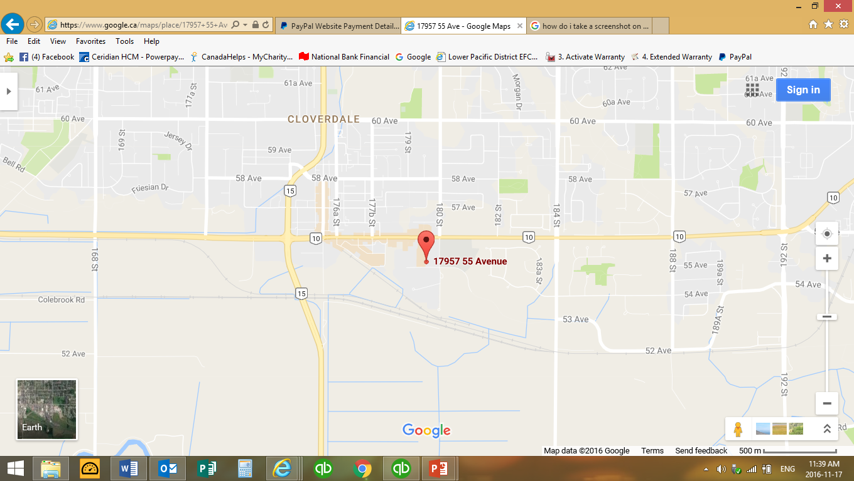
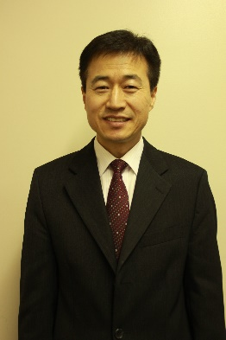
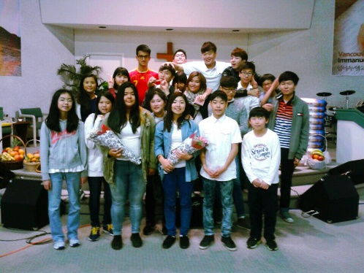
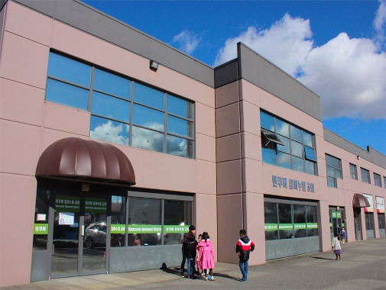
Immanuel Korean Church
LPD Church of the week
Please pray for Pastor Young Jin and Mi-sun Song as they seek to reach Koreans in Cloverdale. Please also pray for this time of transition of staff in the church and also that God will fill the need for Sunday School teachers. Immanuel Korean Church will celebrate their 19th anniversary on December 4 2016!
Immanuel Korean Church 17957 55 Ave, Surrey

